Slide 1
Kitsap County Sheriff’s Office
Schon Montague #92
Community Resource Officer
smontagu@kitsap.gov

Slide 2
Agenda
-Youth in Crisis-
Introductions
Community Partnerships
Information Exchange
Google Kitsap Sheriff
Click on Crime Prevention for more tips

Slide 3
Youth in Crisis
Introductions

Slide 4
Youth in Crisis
Community Partnerships
What is crisis?
Who is in crisis (me and/or my child)?
Is Law Enforcement response different for disabled youth?
What caused the crisis?
What do I tell 911 when I call?
What happens when Law Enforcement arrives?
What about domestic violence laws?
What can Law Enforcement do?
What training does Law Enforcement have?
What can’t Law Enforcement do and why?

Slide 5
What is Crisis?
Definitions
Criminal Law
RCW 82.08.02917 – Any youth under 18 years of age who is either: Homeless, a runaway, abused, neglected, abandoned by a parent, suffering from substance abuse, or mental disorder.
Webster
An unstable or crucial time or state of affairs in which a decisive change is impending

Slide 6
What is Crisis?
Definitions
Social Services
A situation or period in an individual’s life that produces an overwhelming emotional response. This event occurs when an individual is confronted by a certain life circumstance or stressor that he or she cannot effectively manage by using his or her usual coping skills. Crisis is an unexpected event that can create uncertainty to an individual and has been viewed as a threat to a person’s important goals.
Stressor
Coping ability
Clearly define the issue before we can talk about it
Crisis

Slide 7
Who is in Crisis?
Based on the definition, could a parent in crisis be
a contributing factor to sending a youth into crisis?
Self-care is vital to avoiding youth crisis
You can’t help others unless you help yourself first
Always put your oxygen mask on first
Is crisis a regular response?
Work on expanding those coping skills for you and youth
Non-verbal communication
Your words only represent 10 % of communication
Your tone, voice, and body language are heard by your youth
Catalyst for change
You are here – You showed up – You have my respect
You should not be in competition with the Jones’ you. You should be in competition with yourself

Slide 8
Is Law Enforcement response different with DD/ED youth?
Short answer
No not really
Longer answer
We treat every situation based on the facts presented
We never actually “know” what we are walking into
Misrepresentation
Miscommunication
Crisis response
Fight or flight

Slide 9
What caused the crisis?
What is the crisis causing?
What is the root cause of the crisis
Understand the why
The symptom is not the cause
Anger is a secondary emotion
Is the crisis causing damage to property?
Is the crisis causing physical harm to persons?
Is the crisis causing emotional harm to persons?

Slide 10
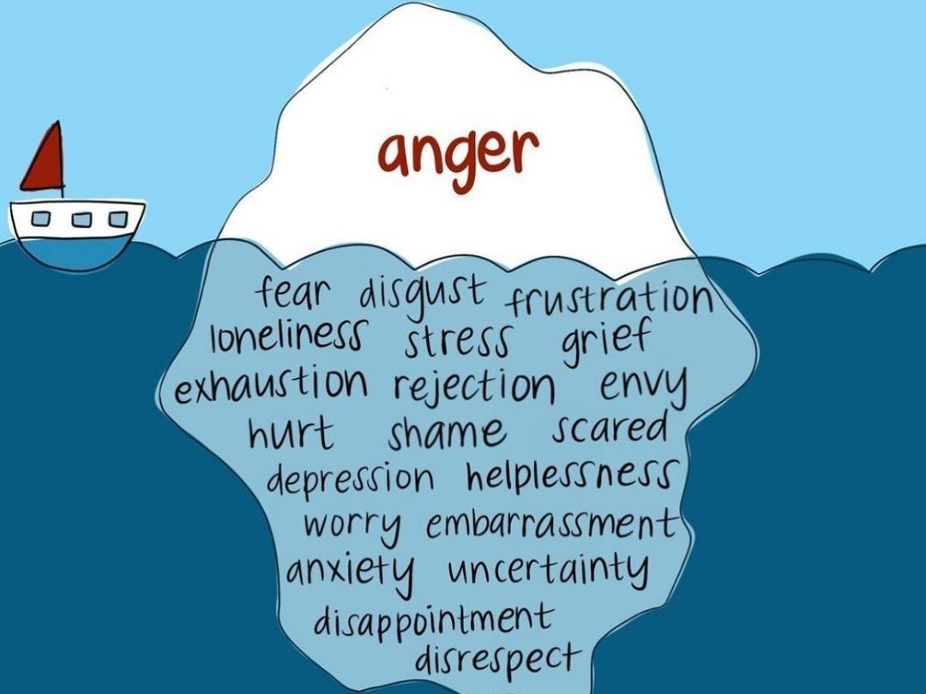
What do I tell 911 when I call?
911 dispatchers answered over 185,000 calls for service in 2022
Order of operations for a crisis
Where
Cell phone traces take time, know where you are, it might not just happen at home
What
Quick classification- my autistic child is in crisis and physically acting out
When
Weapons/Welfare
Who
They will want full name and date of birth of all parties
Details about hooks and triggers

Slide 11
What happens when Law Enforcement arrives?
Law Enforcement is a broadsword not a scalpel
Protect life and property
RCW 10.93.020 …having as its primary function the detection and apprehension of persons committing infractions or violating the traffic or criminal laws in general…
Maintain order
Law Enforcement has evolved to
Provide aid
Mental health counselors
Drug treatment counselors
Parents
Social service provider
Compare to lawyers and doctors

Slide 12
What happens when Law Enforcement arrives?
You are going to have to repeat yourself
We rarely get the whole story until we arrive
We are going to evaluate if our presence is going to escalate the situation
RCW 43.101.455 … De-escalation in patrol tactics and interpersonal communication training, including tactical methods that use time, distance, cover, and concealment, to avoid escalating situations that lead to violence;…
We are going to attempt de-escalation if contact makes sense
RCW 10.120.010 "De-escalation tactics" refer to actions used by a peace officer that are intended to minimize the likelihood of the need to use force during an incident. Depending on the circumstances, "de-escalation tactics" may include, but are not limited to: Using clear instructions and verbal persuasion; attempting to slow down or stabilize the situation so that more time, options, and resources are available to resolve the incident; creating physical distance by employing tactical repositioning to maintain the benefit of time, distance, and cover; when there are multiple officers, designating one officer to communicate in order to avoid competing commands; requesting and using available support and resources, such as a crisis intervention team, a designated crisis responder or other behavioral health professional, or back-up officers.

Slide 13
What about domestic violence laws?
If a crime occurs, Deputies typically have discretion on how they respond
This is not always the case when it comes to domestic violence
Youth over 18 who assault a household member are subject to mandatory arrest.
Was this a medical emergency or a crime?
Is going to the hospital or other facility an option?
4 hour rule
Are injuries from the youth?
What are the words used by the injured parties?

Slide 14
What can Law Enforcement do?
Law Enforcement wants to help
Law Enforcement has limits in capability and authority
Law Enforcement will Always | Law Enforcement will Sometimes
Talk you through the crisis | Write a report reference this incident
Investigate criminal acts | Talk to your youth when there is no criminal act
Connect you with social service agencies | Not meet your expectations

Slide 15
What training does Law Enforcement have?
Law Enforcement training is ever-evolving
What we did 40, 20, and even 5 years ago is vastly different than now.
De-escalation is not just a good idea, it’s the law
5 months of Basic Law Enforcement Academy
3 month field training program
40 hours a year minimum of in-service training
Continuing education classes
Crisis Intervention Training CIT | Patrol tactics
LGBTQ+ core competency | Effective Communication
The criminal legal system: structural inequalities, sanctions and reform | People first: awareness, challenges, and response to poverty and recidivism
Historical intersection of race and policing | De-escalation

Slide 16
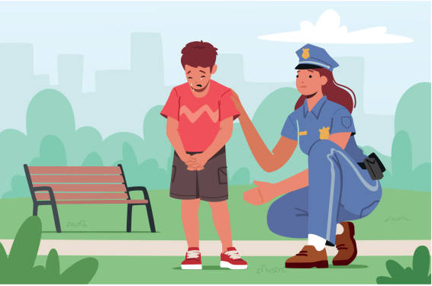
What can’t Law Enforcement do and why?
Law Enforcement will not discipline your child
We always want youth to see us someone they can go to for help
Law Enforcement can not solve problems in 15-30 minutes that took years to create
6-10 deputies serve you from Hansville to Olalla
We received 85,000 calls for service in 2022
Law Enforcement will always prioritize safety
This may result in us not physically responding to your crisis

Slide 17
Youth in Crisis
Questions
What can I reinforce with my youth so that when Law Enforcement arrives, they know what to expect?
Law Enforcement is your friend
Law Enforcement is not there to take bad kids to jail
Provide us the hooks to help with de-escalation
What are typical scenarios my youth might come into contact with Law Enforcement?
As often as possible; community events, fairs, at the coffee shop
In crisis when you are not there or when things have escalated out of your control
When your youth has absconded
What do I teach my youth about calling 911?
Know your address or location
Know a phone number for primary guardian
Know what to do if they are lost

Slide 18
Youth in Crisis
Summary
Law Enforcement are last responders not first responders
Social services are a better tool than us for long term care
Law Enforcement want to help
And there are limitations set on them
Law Enforcement are well trained to de-escalate
They are also human, you never know what their last call was
Youth can sense your non-verbal communication
Sometimes better than your verbal communication
Anger is a secondary emotion
Understand the cause of their anger
Definition of crisis-
is an overwhelming emotional response
they can not manage using coping skills
is viewed as a threat to the person in crisis

Slide 19
Youth in Crisis

Slide 20
Youth in Crisis

Slide 21
Youth in Crisis
Information Exchange
Google Kitsap Sheriff
Click on crime prevention for more safety tips
Deputy Schon Montague
smontagu@kitsap.gov

