Slide 1
Kitsap Coordinated Grant Application 2025 for 2026
Technical Assistance
SERVICES projects
May 29, 2025

Slide 2
Welcome!
Technical Assistance Session for the
2026 Coordinated Grant Application Cycle for
Mental Health, Chemical Dependency, and Therapeutic Courts.
Applications are used for:
CDBG: Community Development Block Grant
HOME: Investment Partnership Program
AHGP: Affordable Housing Grant Program
HHGP: Homeless Housing Grant Program
CHG: Consolidated Homeless Grant
CIAH: Community Investments in Affordable Housing
MHCDTC: Mental Health, Chemical Dependency, and Therapeutic Courts
City of Bremerton CDBG

Slide 3
Introductions
Kitsap County Staff
Hannah Shockley

Slide 4
Agenda
Overview of 2026 Coordinated Grant Process
2026 Application – Two Parts
Filling Out the Application in SurveyMonkey Apply
Application Review and Awards Process
Getting Help and Questions
Q&A

Slide 5
Overview of Coordinated Grant Application Process

Slide 6
Overview of 2026 Coordinated Grant Application Process
How we coordinate:
Preapplications are reviewed by the entire CGAP Team to determine eligible funding for applicants
Same online Application Platform for all applications through SurveyMonkey Apply
Applicants have access to all their applications in a single place, across multiple funding sources
We share access to the Organizational portion of the application, so applicants only have to submit that information once

Slide 7
Overview of 2026 Coordinated Grant Application Process
Where we cannot coordinate:
Based on the funding source: { Federal, State, Local }
Each has separate requirements for eligibility and for what needs to be collected from applicants
This means funding source specific applications must be submitted
Applications consist of two parts:
Part 1: Organization Application – complete once for your agency
Part 2: Services Application – complete one for each project you are requesting funding for. You will be notified before applications open, identifying for you which applications to submit.

Slide 8
2026 Application Two Parts

Slide 9
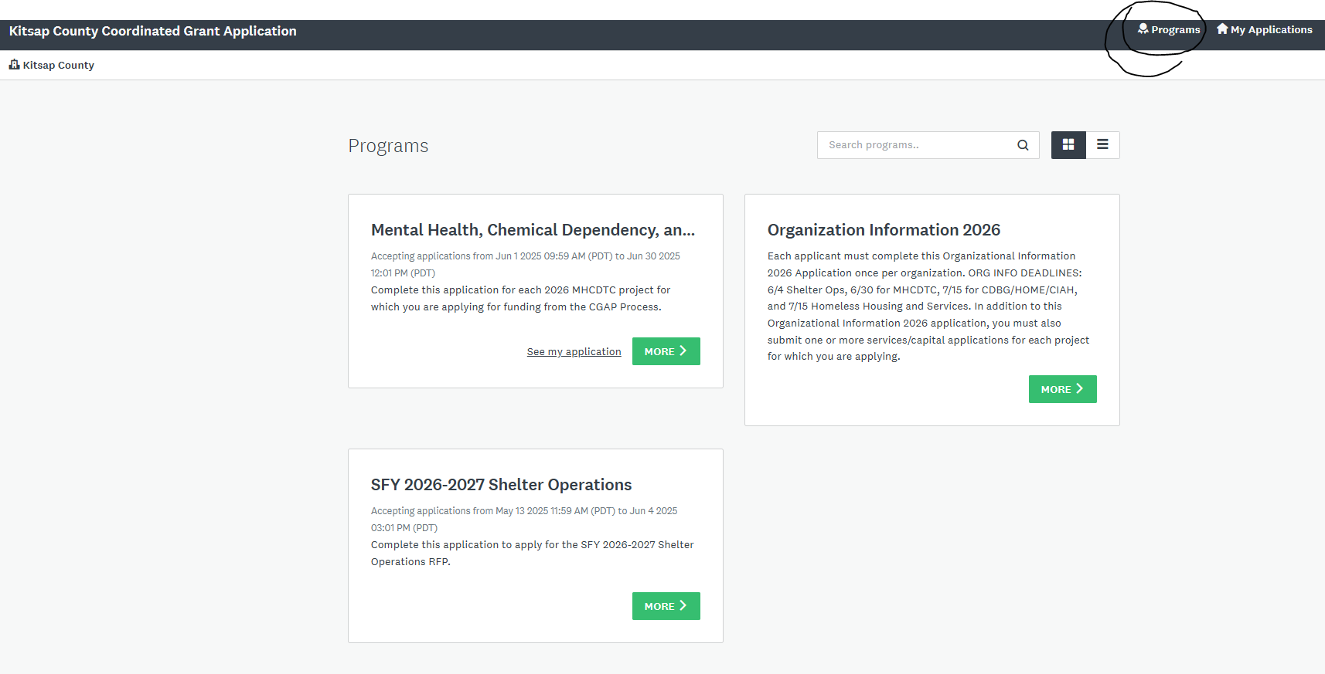
As applications open, you will see them available on the “Programs page”. To get back to the programs page, click Programs button top right.

Slide 10
Part 1 - Organization Information
Only submit once for ALL 2026 Coordinated Grant Applications
Part 1 includes
Applicant Organization Information
Organizational Chart
Board Information
Agency Budgets, Financial Statements & Audit
Fiscal & Procurement Policies
Non-Discrimination Policies & Procedures

Slide 11
Part 2 – Project Information
Submit ONE Part 2 Application for EACH project.
Part 2, Project Information Application, is divided into 5 tasks:
Pre-Application Identified Funding Sources
Program Description and Narrative 2026
Need and Population 2026
Financial Information
Program Attachments

Slide 12
Part 2 – Project Information Tasks
Program Description and Narrative 2026
Program Information – location, service area, number served
Funding Request and What the Funding Will Be Used For
Contact Information
Type of Program and Program Summary
Program History, Challenges and Best Practices
Program Staff
Complaint Process
Access to Care
Advancing Equality

Slide 13
Part 2 – Project Information Tasks
Need and Population Served 2026
Community Need and Impact
Does the project meet a goal and objective in the Strategic Plan
What research have you done to collect data to show community need
How can you validate the need
Target Population and Income Level
Benefit to Individuals
Community Impact and Collaboration
Outreach to Target Population
Culturally Competent Care
Trauma Informed Care

Slide 14
Part 2 – Project Information Tasks
Financial Information
Budget (project budget and if you have sub-contractors budgets)
Funding Commitments
Years Receiving Funding, Collectively
Sustainability Plan – if funding gets reduced how will you sustain your program
Program Attachments
Varies by funding source
You will only see form(s) you need to complete

Slide 15
Complete Application
Don’t forget that a complete application consists of two parts:
Organization Information Application has been submitted for the Agency (only required once)
Project Application has been submitted for each funding source identified from your preapplication review

Slide 16
Application Basics and Demonstration

Slide 17
2026 Coordinated Grant Application
The Coordinated Grant Application is 100% ONLINE
Step 1: On or after June 1st go to the Kitsap Coordinated Grant Application website using the links provided in the email from our office.
Step 2: New applicants will need to create a new account. Returning applicants will log in with an existing account.
Step 3: Get started!
Save your work often! You may save, log out, and resume later where you left off. Multiple members of your agency may contribute at different times to the application.

Slide 18
For NEW Applicants
Accessing the Website
Registering a New Account
How to Access the CGA Grant Application Website and Create a New Applicant User Account

Slide 19
Accessing the CGA Website
You will receive an email following the review of preapplication submission, if you are eligible. This email will include instructions and links to the application forms you will need to complete registration to submit your Services Application(s).
Access the website using this link: https://apply-kitsap.smapply.io/
Hi Jason,
Thank you for meeting to talk through your project.
We wanted to share a few reminders with you:
The remote {SERVICES TA SESSION} will be held {DATE} via Zoom.
Please join the session using this link -> {http://kcowa.us/cga-services-ta}
If you are unable to join the session live, a recording/slides presentation will be made available on the Coordinated Grant Application website.
Applications will open on June 1st and close on June 30th.
The applications consist of two parts, an Organizational Information Application which is only submitted once for your organization and a project application which is submitted for each project or program you are applying for.
The Organizational Information Application can be accessed by clicking on this link {https://apply-kitsap.smapply.io/prog/organization_information_2026 }
Click on the link(s) below to access the project application(s):
{PROJECT NAME} {https://apply-kitsap.smapply.io/prog/services_application_2026}
Thank you for all the work you do, and please let us know if you have any questions about the process.

Slide 20
Registering a NEW Applicant Account
Select the “Register” link along the top of the website to begin registering a new applicant primary account
2026

Slide 21
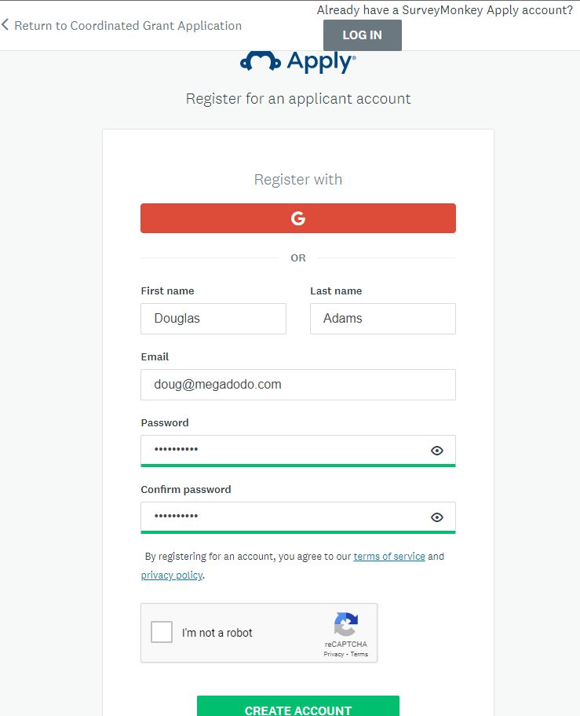
Register on Apply
Create an account for your Primary or Managing User
Passwords must be at least 8 characters, with at least 1 uppercase letter, 1 lower case letter, 1 number, and 1 special char@cter
Check “I’m not a robot” and complete the Captcha
Finally “Create Account”

Slide 22
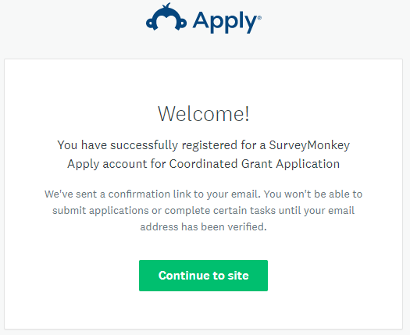
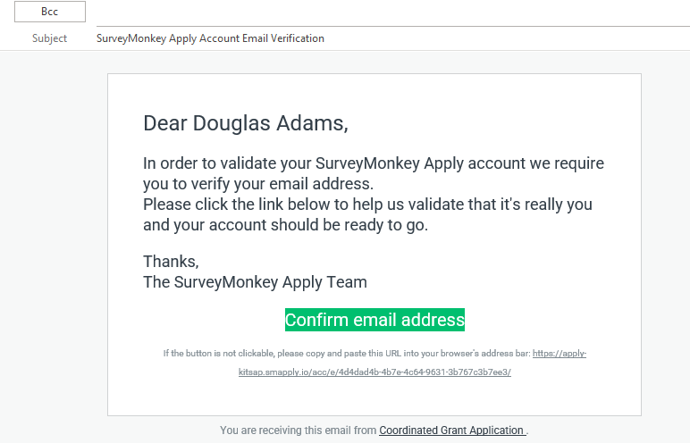
Welcome!
After registering you will receive a confirmation email.
YOU MUST verify your account using the link in the email. You will not be able to submit your application or complete some steps without clicking the verification link

Slide 23
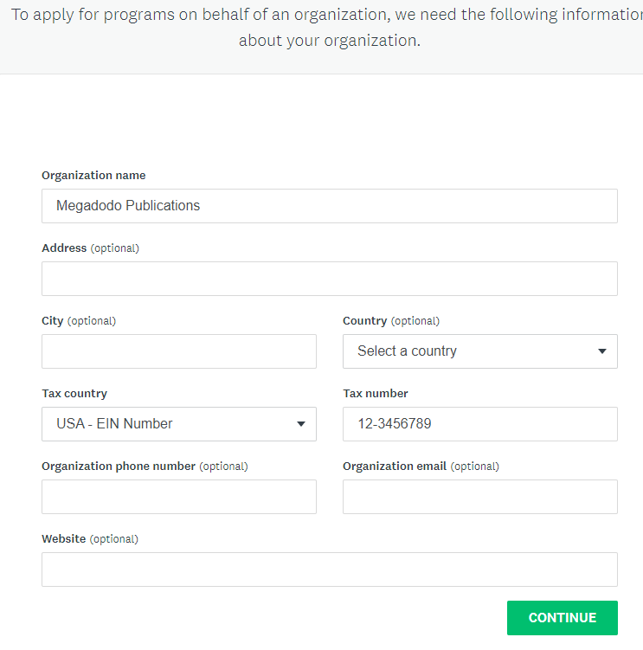
Manage your Organization
After creating your Primary account, you will need to complete some basic information about your organization.
This will allow you to create an organization, where you may add multiple members/users who can work on an application collaboratively. We will discuss adding additional members shortly.
Users who register separate Primary accounts cannot collaborate on the same application.
Complete the following:
Organization Name
Tax Number

Slide 24
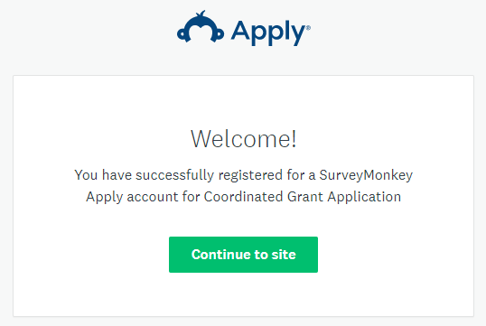
Registered Successfully

Slide 25
For RETURNING and NEW Applicants
Accessing the Website
Resetting Passwords
Adding Members or Collaborators
Changing your Primary Account User
How to Access the CGA Grant Application Website and Manage your accounts

Slide 26
Accessing the CGA Website
You will receive an email following the review of preapplication submission, if you are eligible. This email will include instructions and links to the application forms you will need to complete registration to submit your Services Application(s).
Access the website using this link: https://apply-kitsap.smapply.io/
Hi Miranda,
Thank you for meeting to talk through your project.
We wanted to share a few reminders with you:
The remote {SERVICES TA SESSION} will be held {DATE} via Zoom.
Please join the session using this link -> {http://kcowa.us/cga-services-ta}
If you are unable to join the session live, a recording/slides presentation will be made available on the Coordinated Grant Application website.
Applications will open on June 29 and close on July 27.
The applications consist of two parts, an Organizational Information Application which is only submitted once for your organization and a project application which is submitted for each project or program you are applying for.
The Organizational Information Application can be accessed by clicking on this link {https://apply-kitsap.smapply.io/prog/organization_information_2024 }
Click on the link(s) below to access the project application(s):
{PROJECT NAME} {https://apply-kitsap.smapply.io/prog/services_application_2024}
Thank you for all the work you do, and please let us know if you have any questions about the process.

Slide 27
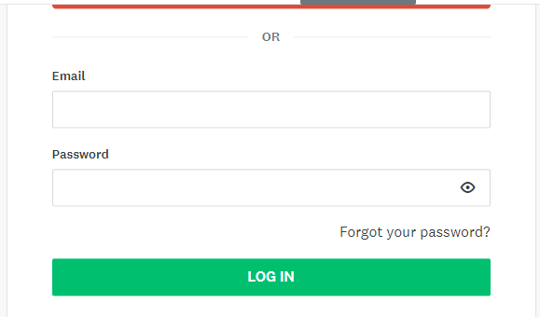
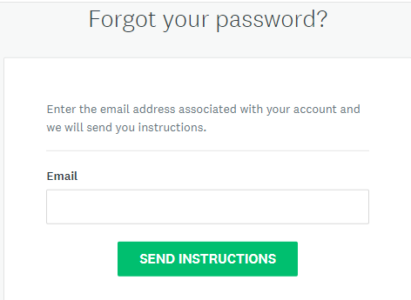
Password Reset
Are you a New or Existing User and you have forgotten your password?
Go to the homepage at https://apply-kitsap.smapply.io/
Click “Log In”
Under the Password field click “Forgot your password?”
Enter the email address that you use to log into the site
Click “Send Instructions”
Click the link in the email you receive
Enter a new password
Click “Reset Password”

Slide 28
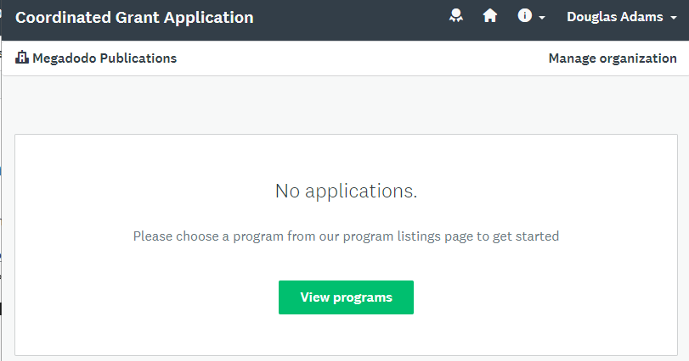
Add Members or Collaborators
If you will have multiple users working together on an application, use the following steps to create user accounts for your members.
After Logging in with the Primary Account, Select “Manage Organization” from the menu bar.

Slide 29
Add Members or Collaborators
From the Manage Organization page select the “Members” tab
Next select the “Add member” button

Slide 30
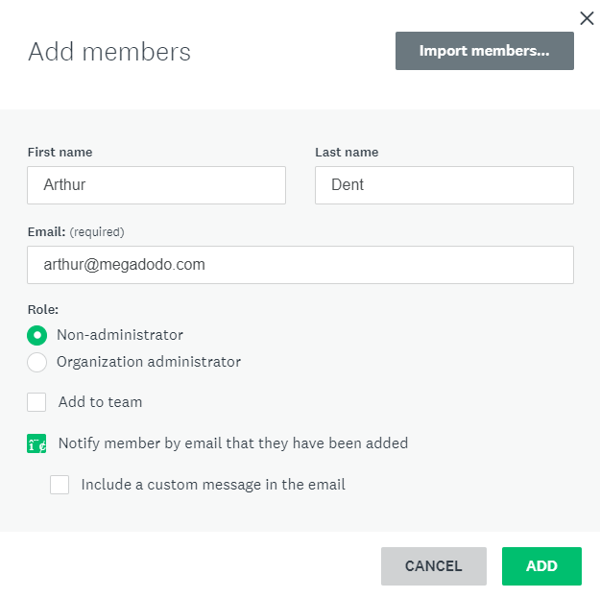
Add Members or Collaborators
Create the member by entering their name, email, and select “Notify member by email that they have been added”. This will send the user an invitation email.
The added member will need to select the “Join now” link in the invitation email.

Slide 31
Transferring Primary Account
When an organization is first registered, the user that registered the organization will become the Primary Administrator. If you are the Primary Administrator you have the option of transferring this access to another member of the organization:
Login as an organization administrator
Click on Manage Organization in the top right corner
Click Profile
Click Transfer Primary Administrator
Select the new primary administrator
Click Transfer. You will be removed as the primary administrator of the organization and will be given Non-Administrative permissions to access the organization's applications.
NOTE: If you are currently an organization administrator and wish to become the Primary Administrator, for example, if the original Primary Administrator has left the Organization, we would recommend contacting CGA Staff for further assistance.

Slide 32
Creating An Application
Overview of the Coordinated Grant Application Site
Viewing the Available Application Types
Creating An Organizational Information and a Project Application
Starting an Application
Creating a Part 1 – Organizational Information 2026 Application
Creating a Part 2 - Applications 2026

Slide 33
Overview of the CGA Website
After Logging in to the Coordinated Grant Application Website, you will default to the “My Applications” page.
To create an application, follow the links provided in your Pre-Application follow-up email, or navigate to the “Programs” Link in the SM Apply Menu bar.
Hi Douglas,
Thank you for meeting to talk through your project.
We wanted to share a few reminders with you:
The remote {SERVICES TA SESSION} will be held {DATE} via Zoom.
Please join the session using this link -> {http://kcowa.us/cga-services-ta}
If you are unable to join the session live, a recording will be made available on the Coordinated Grant Application website.
Applications will open on June 29 and close on July 27.
The applications consist of two parts, an Organizational Information Application which is only submitted once for your organization and a project application which is submitted for each project or program you are applying for.
The Organizational Information Application can be accessed by clicking on this link {https://apply-kitsap.smapply.io/prog/organization_information_2024 }
Click on the link(s) below to access the project application(s):
{PROJECT NAME} {https://apply-kitsap.smapply.io/prog/services_application_2024}
Thank you for all the work you do, and please let us know if you have any questions about the process.

Slide 34
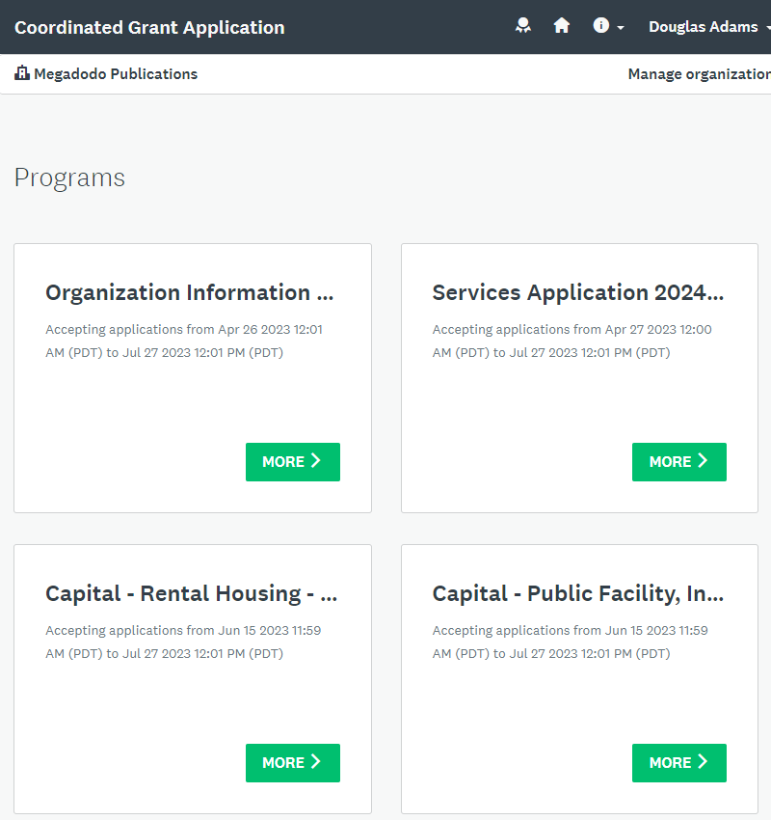
Program Page
The Programs page will display all the available Application Types occurring during the Coordinated Grant Application process, including:
If you don’t see it, it hasn’t opened yet.
Organizational Information 2026
MHCDTC
Services Applications 2026
Capital – Rental Housing – 2026
Capital – Public Facility, Infrastructure, Shelter – 2026
Shelter Operations 2026

Slide 35
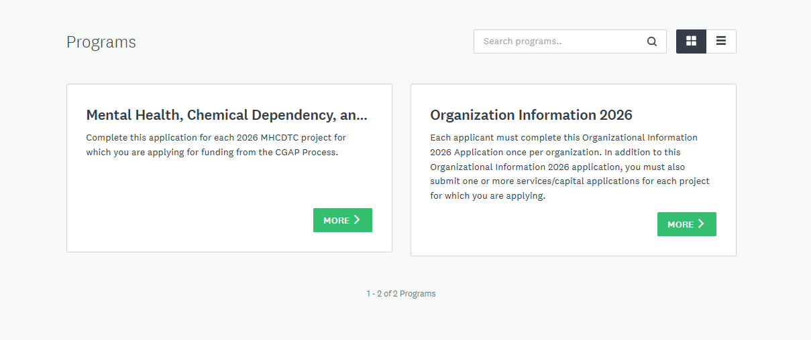
Depending on when you log in to complete your application, the Programs page will have only these applications available on June 1, 2025.

Slide 36
Starting an Application
To Start an Application, open an application link from your Pre-Application Follow-up email from CGA staff, or from the Program Page select a “More>” Link to see details about the program application
The applications consist of two parts, an Organizational Information Application which is only submitted once for your organization and a project application which is submitted for each project or program you are applying for.
The Organizational Information Application can be accessed by clicking on this link {https://apply-kitsap.smapply.io/prog/organization_information_2024 }
Click on the link(s) below to access the project application(s):
{PROJECT NAME} {https://apply-kitsap.smapply.io/prog/services_application_2024}
Thank you for all the work you do, and please let us know if you have any questions about the process.

Slide 37
Each Program Page will Contain
General Instructions
General info about navigating the online application, downloading/uploading, submitting, reviewing and editing. We recommend printing these instructions for easy reference.
Application Instructions
Question-by-question guidance on answering questions and filling out the application. We recommend using these to create a Word document to complete narrative questions and then paste them into the application.
Forms and Worksheets
Most Applications will contain a Budget Worksheet, Performance Measures, and other documents that you will need to complete and attach to your application.
These forms are available now before the Applications go live and are also linked within the applications themselves.

Slide 38
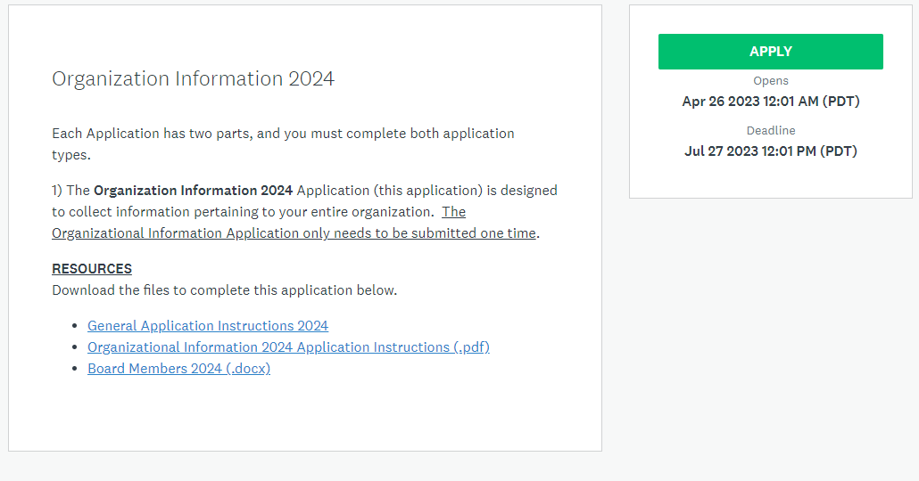
Part 1 – Organizational Information 2026
2026
Every Applicant MUST complete this Part 1 – Organizational Information Application ONE TIME
2026
2026
2026
2026

Slide 39
Part 1 - Organizational Information Application
2026
2026
To start the application click Apply
Forms to be completed and uploaded for specific questions in the application and Instructions. Download and save these first before clicking Apply.
2026
2026
2026

Slide 40
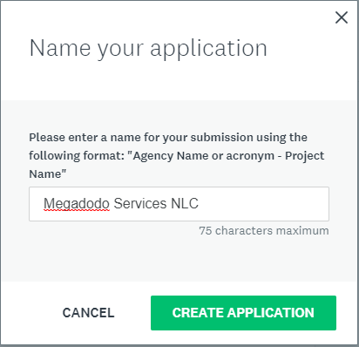
Name the Application
Name the Organizational Information Application by the Agency Name

Slide 41
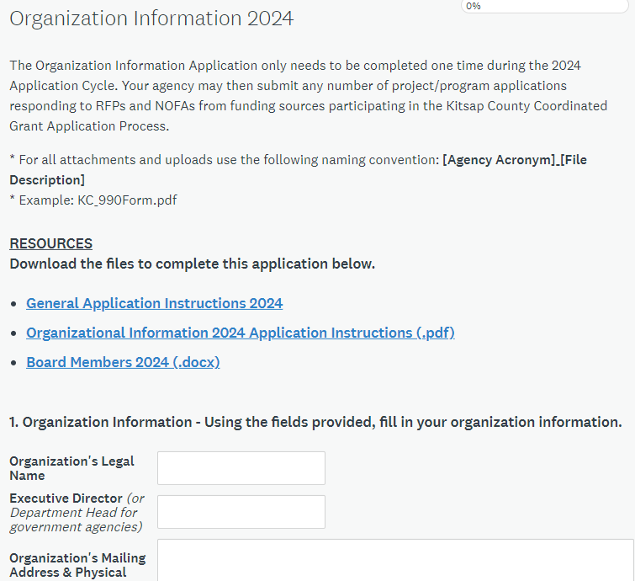
Part 1 - Organizational Information Application
Every Applicant must submit ONE Organizational Application 2026 for their Organization.
This Application has 3 Pages. You must complete each Page before you may move to the next page
Page 1 – Organization Info
Upload Org Chart, Board Members Worksheet, Bylaws, and Annual Board Minutes
Page 2 – Staff and Budget
Upload Agency Budget, Financial Statements, Balance Sheet, Cash Flow, and Audit as needed
Page 3 – Financial, Fiscal, and Policies
Upload IRS 990 tax return, Agency Annual Report (if available), Fiscal Control Policies, Procurement Policies, and Non-Discrimination Policies

Slide 42
Part 1 - Organizational Information Application
You must complete all questions on a page before you can proceed to the next.
Save your work frequently – use the “Save and Continue Editing” button
Safest method: download instructions and complete all narratives and forms prior to working in SurveyMonkey Apply.
Less safe: working directly in SurveyMonkey, using “placeholder” answers, and uploading “temporary files”.
Less safe can mean incomplete submissions!

Slide 43
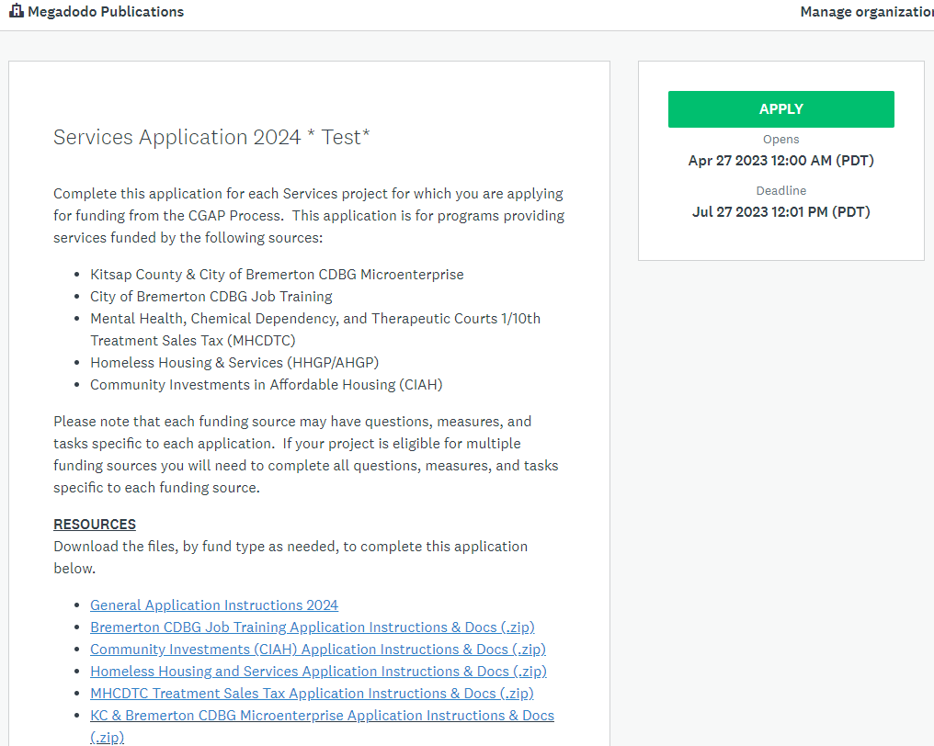
Part 2 – Application 2026
Every Applicant must complete a Part 2 – Application 2026 for EACH Project for which they are submitting

Slide 44
Part 2 – Application 2026
To start the application click Apply
Forms to be completed and uploaded for specific questions in the application and Instructions. Download and save these first before clicking Apply.

Slide 45
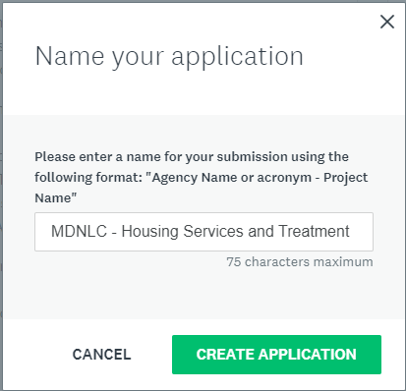
Name the Application
Give the application a name for the project or program.
Please make sure to include your Agency Name or Acronym with the project name, so that staff and reviewers will know which Projects are submitted by the Agency

Slide 46
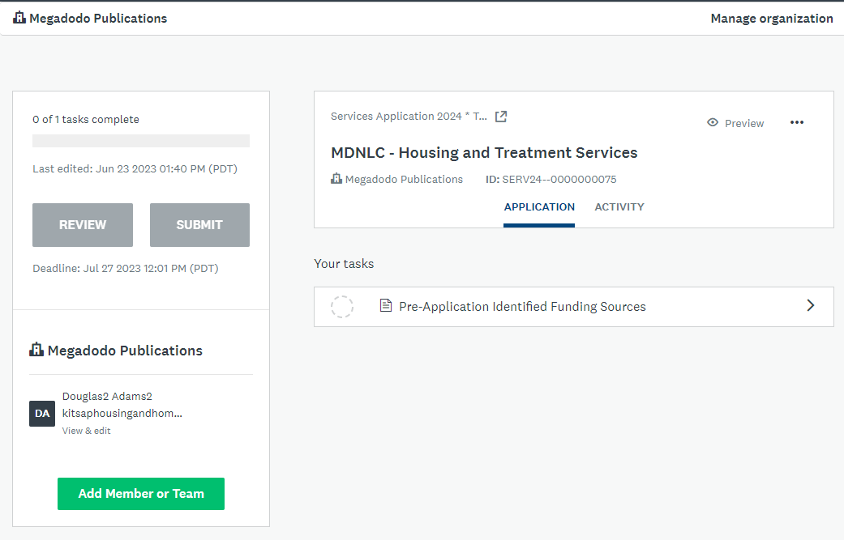
Services Application Dashboard
You can add members you created from the primary account here to collaborate on the application

Slide 47
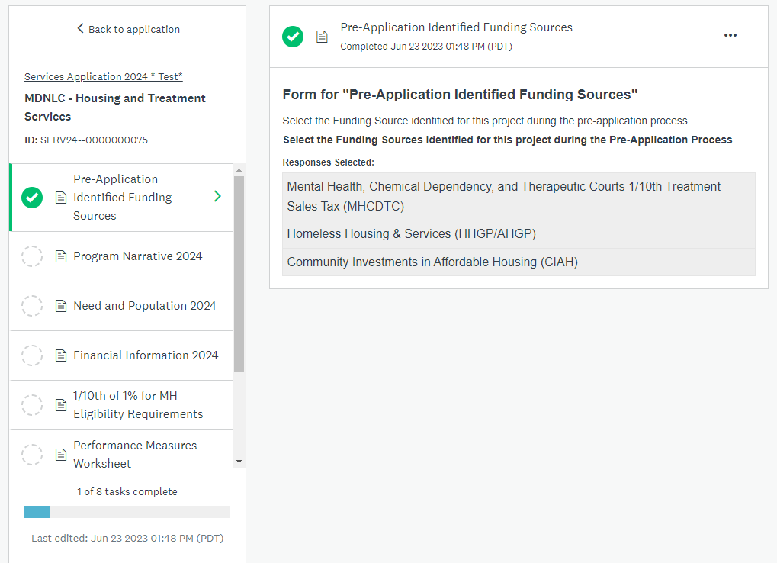
Additional Tasks Created
Tasks are listed. As you complete them, they will have a check mark.
Every task must be completed before your Part 2 Application can be submitted

Slide 48
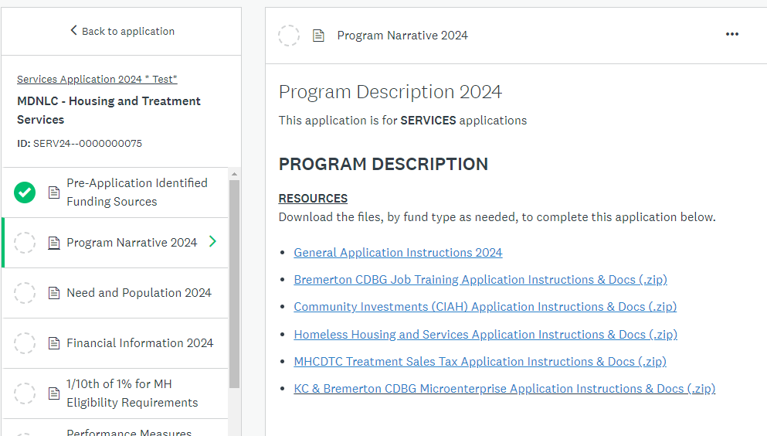
Instructions, Forms, and Worksheets
You can find all of the instructions and forms needed in the “Program Description” task at the top of the page
Links to forms and references will also be linked within the questions as needed.

Slide 49
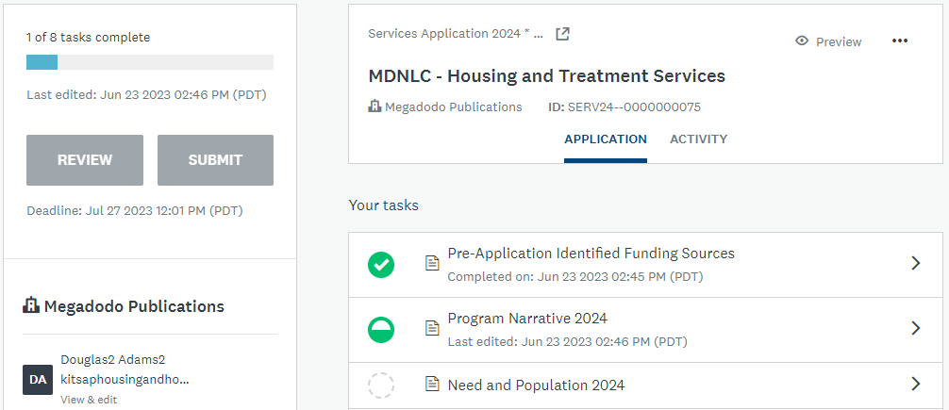
Application Dashboard
The Application Dashboard will display:
Tasks that are complete (green circle with check)
Tasks that have been started (half full circle)
Tasks that have not been started (empty circle)
Number of tasks complete
When ALL Tasks are complete the Submit Button will show in green, and applicants will be able to review and submit the application

Slide 50
If Applying for Multiple Funding Sources
If the project has been identified as eligible for multiple funding sources, the completed application will be submitted simultaneously to each funding source reviewer staff and committee/board.
Fund sources have some specific questions, tasks, or Performance Measures that are unique to that fund source. Applicants will be conditionally shown questions and tasks relevant to the selected fund sources.
MHCDTC Sales Tax
CDBG Microenterprise
Homeless Services
Bremerton Job Training
Affordable Housing CIAH

Slide 51
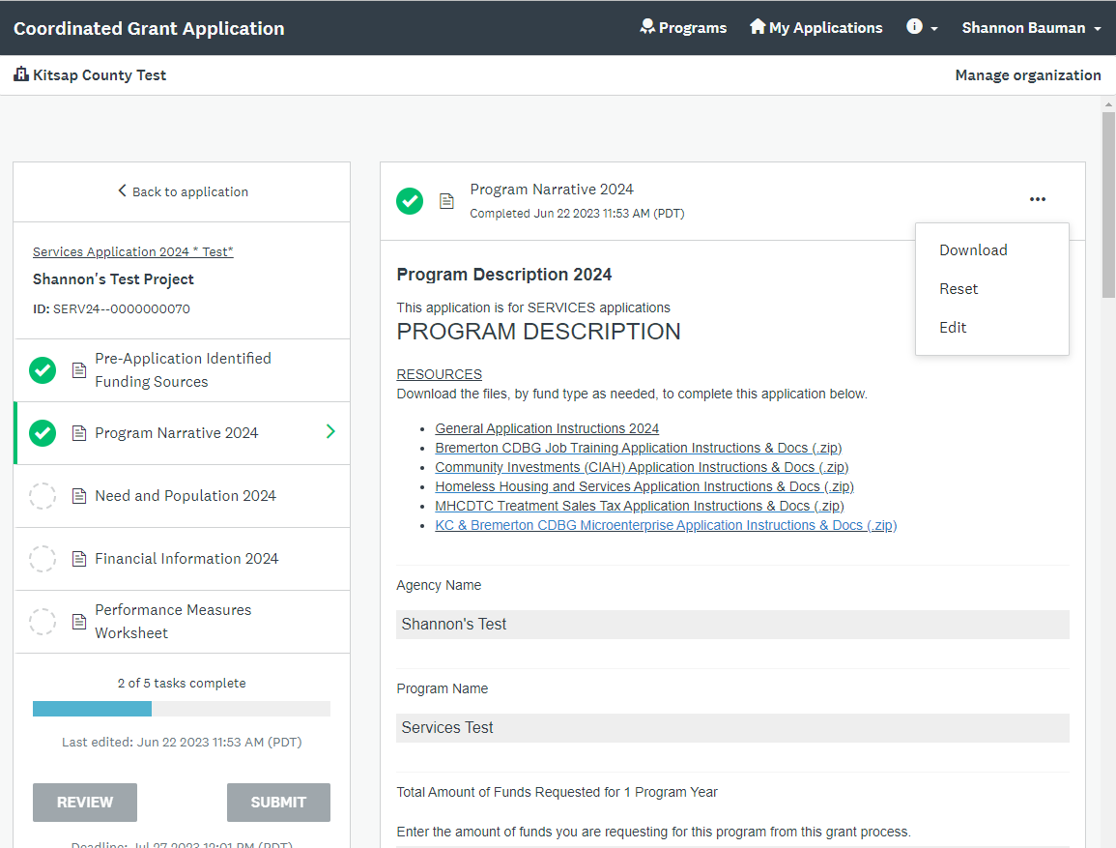
To Edit a Completed Task
Choose the task you want to edit and then click here to select Edit from the pop-up menu

Slide 52
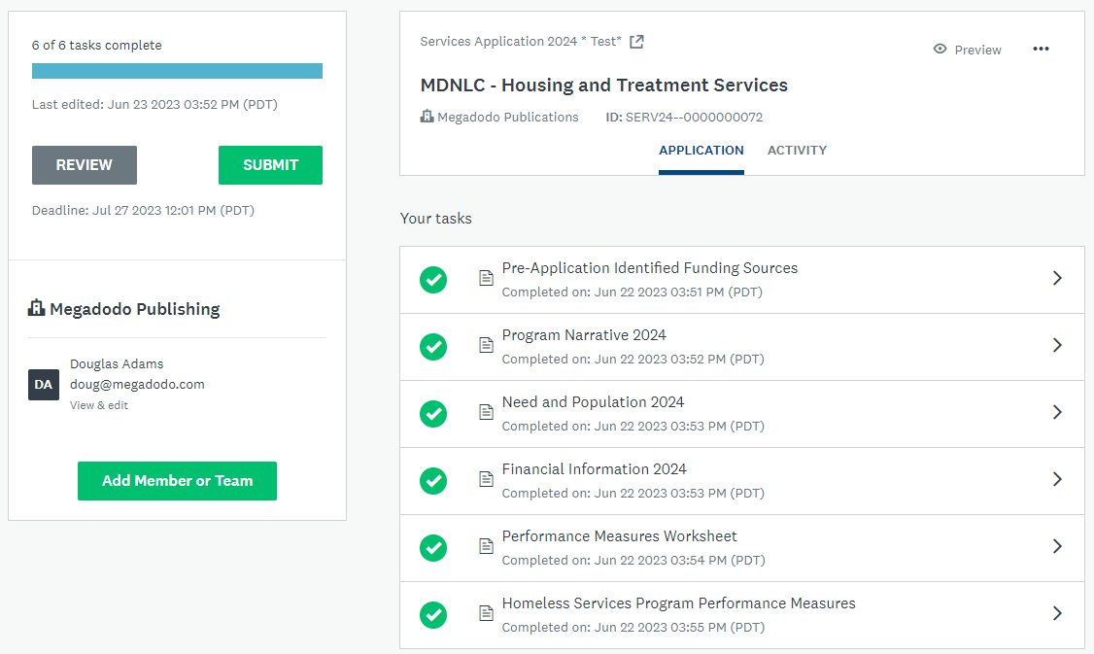
Submitting a Completed Application
Once you have completed all the tasks for your application you will see green check marks. When all tasks have been completed the SUBMIT button will turn green and allow you to submit your application. You will receive an email from the system.
You may edit your application after you have submitted until the application closes at Noon on June 30th.

Slide 53
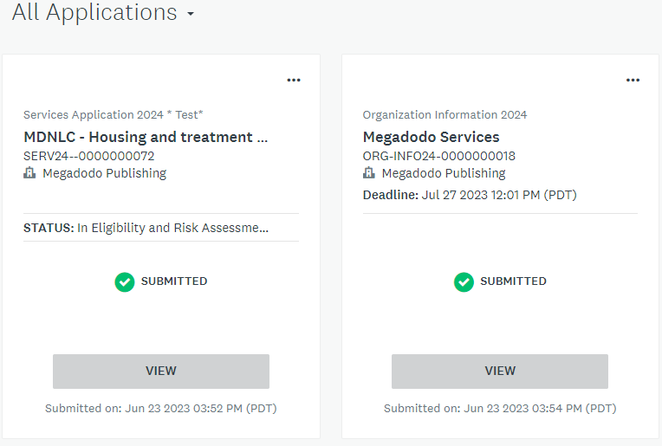
COMPLETE Applications Must Include
Part 1 – Organizational Information 2026
Part 2 – Services Application 2026
Part 1 – Organizational Information 2026 *Complete*
Part 2 – Services Application 2026 *Complete* For each Services project

Slide 54
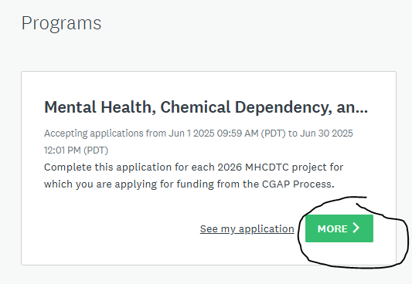
To Submit Multiple Grants :
Log in and click Programs (top right)
Click MORE on Grant you wish to apply for again with a separate program

Slide 55
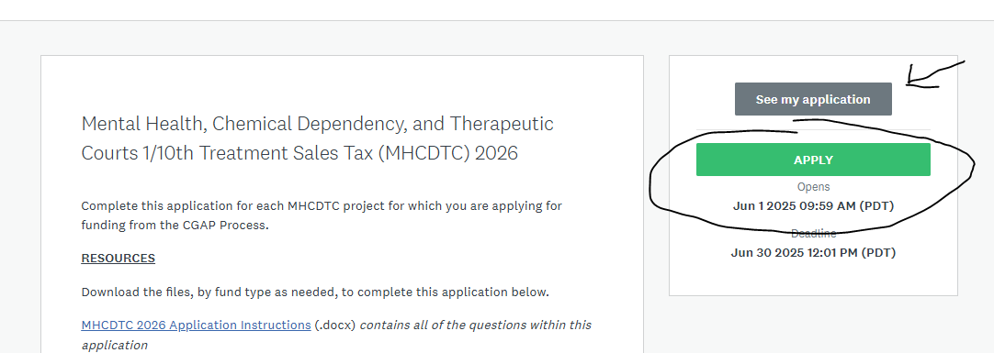
You’ll see the option to view your submitted application or saved application or APPLY. Choose apply to start a new grant request.

Slide 56
5 TIPS FOR A GREAT APPLICATION
Give the full story about your project within the parameters of the question and instructions provided.
Have someone else proofread – checking for clarity, content & continuity (and typos)
Double check your math – do the budget forms correctly!!!
Make sure you have uploaded the correct forms
Don’t wait until the last minute to submit your application!

Slide 57
Application Assistance

Slide 58
2026 Coordinated Grant Application
If you need assistance…
Technical Assistance: Survey Monkey Apply
For technical assistance for trouble with the site, or other website related issues. Click on the icon in the upper right-hand corner and click on one of the options
Application Assistance: Coordinated Grant Staff
If you don’t understand what the application is requesting, how the forms or attachments work, whether your project is eligible, or any other issues related to agency or project information, contact CGA Staff.

Slide 59
Review and Awards Process

Slide 60
Review & Award Process
Part 1: Risk Assessment & Eligibility Review
Staff will review all applications submitted for organization and program eligibility
Part 2: Eligible Applications Reviewed & Scored by Community Advisory Committee
Overall Project Description
Timeline – readiness to proceed
Project Management Experience
Need and Population Served
Project Financial Feasibility
Impact
Alignment to the Strategic Plan

Slide 61
Review and Award Process
MHCDTC Funding:
The CAC will review applications in July
Potential Questions may come from reviewers, the Citizen Advisory Committee (CAC) during the month of July.
Online submission of responses to CAC questions are due July 31st by 3pm
The CAC discusses projects & recommends project funding at Executive Sessions on August 4th and 5th
Open CAC Business Meeting on August 6th to announce recommendations at 5:00 p.m.
Recommendations go before the Board of County Commissioner for final approval on August 25th

Slide 62
Assistance

Slide 63
Getting Help
Virginia McCaslin
Kitsap County HHGP/AHGP Programs
vmccaslin@kitsap.gov
Cory Derenburger
Kitsap County HHGP/AHGP Programs
cderenbu@kitsap.gov
Hannah Shockley
Kitsap County MHCDTC Program
hshockle@kitsap.gov
Joel Warren
Kitsap County CIAH Program
jwarren@kitsap.gov
Bonnie Tufts
Kitsap County CDBG/HOME Programs
btufts@kitsap.gov
Shannon Bauman
Kitsap County CDBG/HOME Programs
sbauman@kitsap.gov
Sarah Lynam
City of Bremerton CDBG
Sarah.Lynam@ci.bremerton.wa.us

Slide 64
2026 Coordinated Grant Application
Where to find information………
Application Schedule has key dates
NOFA’s/RFP’s have information regarding eligibility, amount of money available, application access and submission, staff contact info.
Policy Plans have detailed information including regulations and requirements for each fund type.
SurveyMonkey Apply is the online platform for submission of applications and has the application instructions and links to forms.
Staff is available by email for questions and technical assistance.
Coordinated Grant Application Process at http://www.Kitsap.gov/hs/Pages/HH-Coordinated-Grant-Application-Process.aspx

Slide 65
Q&A
We will answer questions that came in during the session and then answer any additional questions – use the Raise Hand feature and we will call on you

