Slide 1
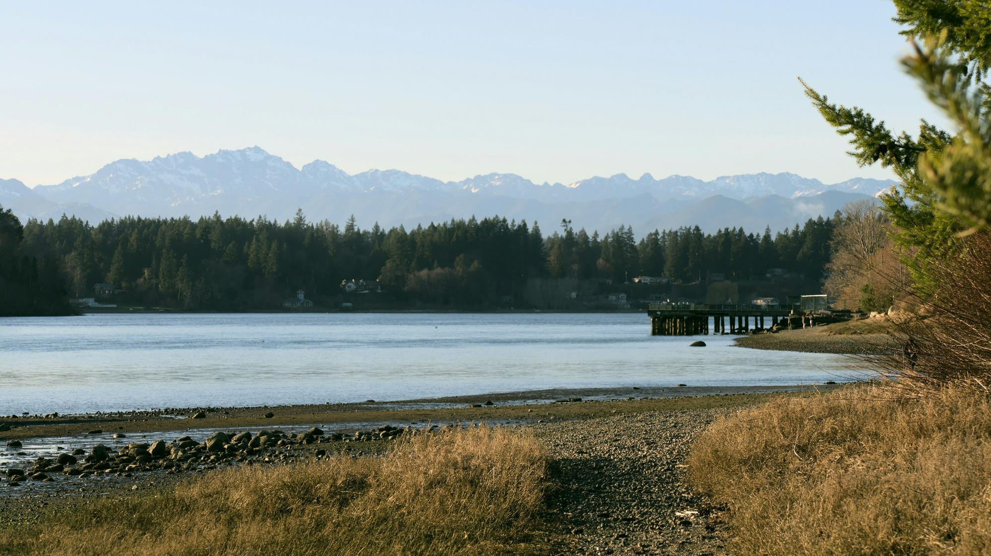




KITSAP COUNTY
Sea Level Rise Vulnerability
and Risk Assessment
Public Open House
September 11, 2024
This project is being funded under a Shoreline Planning Competitive Grant received by the State of Washington Department of Ecology under Grant Agreement No. SEASPC-2325-KiCoCD-00014

Slide 2
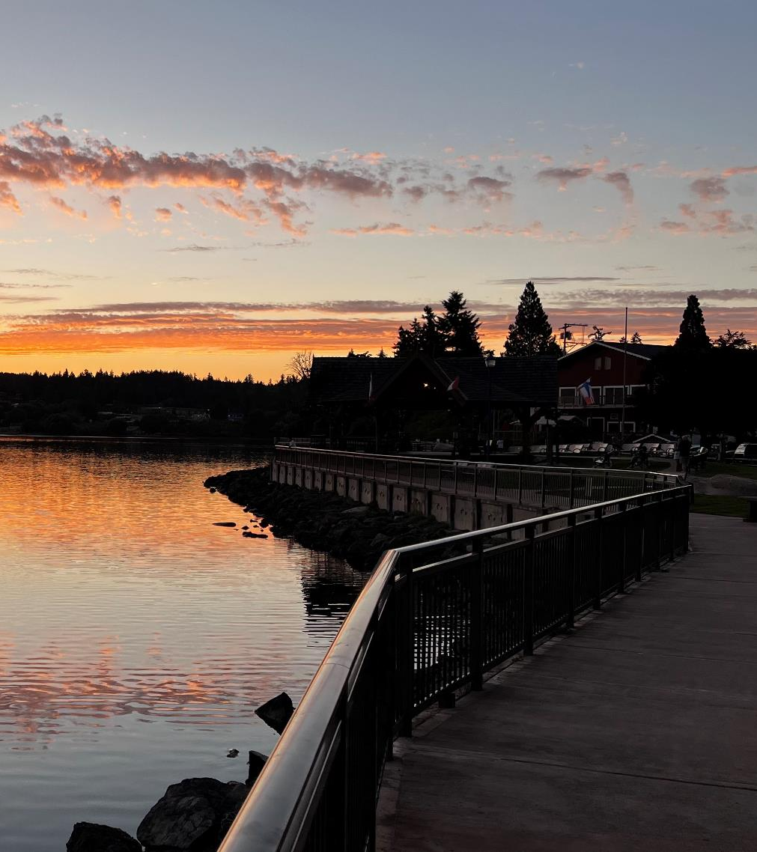
Agenda
Team Introductions
Sea Level Rise Overview
Project Overview
Project Analyses & Outcomes
Community Engagement Overview
Survey and Open House Activities
Next Steps & Questions

Slide 3
Project Team

Slide 4
Intro to Sea Level Rise
Sea level rise (SLR) is the overall increase in the level of the world’s oceans. It is primarily caused by two factors: added water from melting ice sheets and glaciers caused by a warming climate, and the expansion of ocean water as it warms.

Slide 5
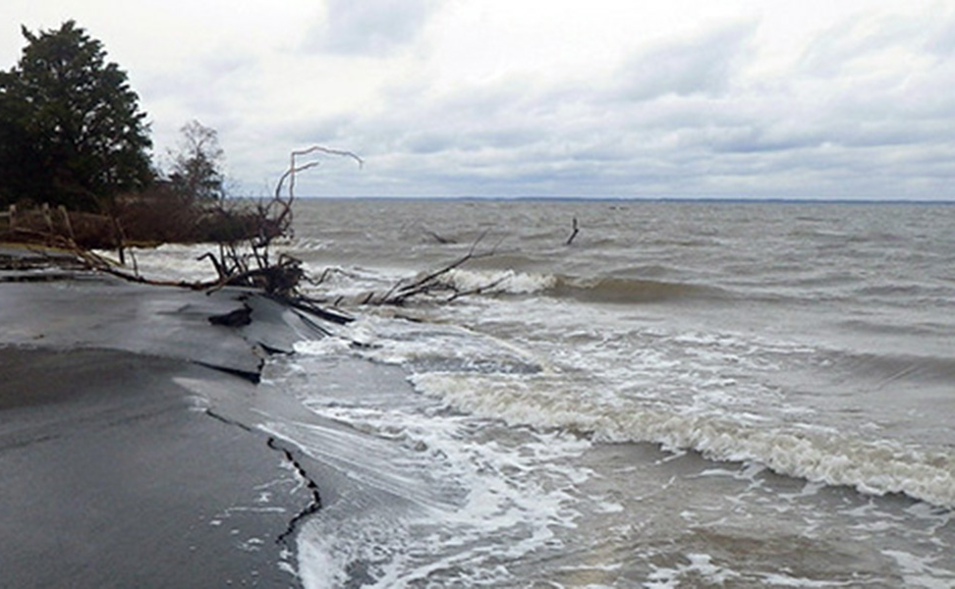
Intro to Sea Level Rise
Coastal storms and extreme high tides will pose more severe threats than they have in the past.
Areas higher and further from the coast that were previously untouched by these coastal hazards will be at increased risk of flooding and erosion.
Some low-lying coastal areas will be permanently inundated, possibly forcing people and wildlife to move out of those areas.
“Climate Adaptation Resources for Washington (CAR-Wash)." Climate Impacts Group, University of Washington, 2024, https://cig.uw.edu/resources/car-wash/.

Slide 6
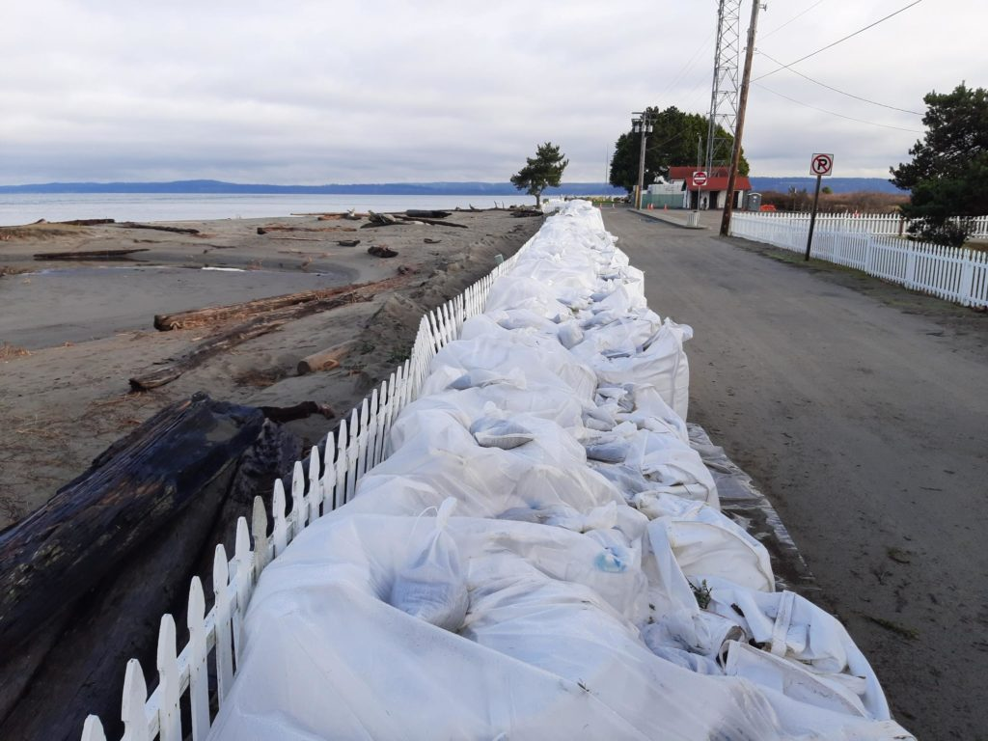
Intro to Sea Level Rise
Sea level rise increases the risk of:
Degraded or destroyed habitats such as wetlands, estuaries and intertidal zones
Damage to homes, roads, buildings and other infrastructure
Hardship for coastal industries, including commercial fisheries and tourism
Loss of culturally important sites
Loss of opportunities for recreation
“Climate Adaptation Resources for Washington (CAR-Wash)." Climate Impacts Group, University of Washington, 2024, https://cig.uw.edu/resources/car-wash/.

Slide 7
Project Purpose
Kitsap County Department of Community Development received a grant from the Washington State Department of Ecology to complete a sea level rise vulnerability and risk assessment to map different projections of sea level rise and identify the potential impacts to natural and built assets.

Slide 8
Project Purpose
Identify
Identify assets with potential for loss of damage from sea level rise.
Complete
Complete risk analysis and vulnerability assessment, based on mapping predictions to be decided by the Technical Advisory Committee (TAC) in July.
Propose
Propose practical region-specific actions or projects, to address increased sea water interactions where appropriate.

Slide 9
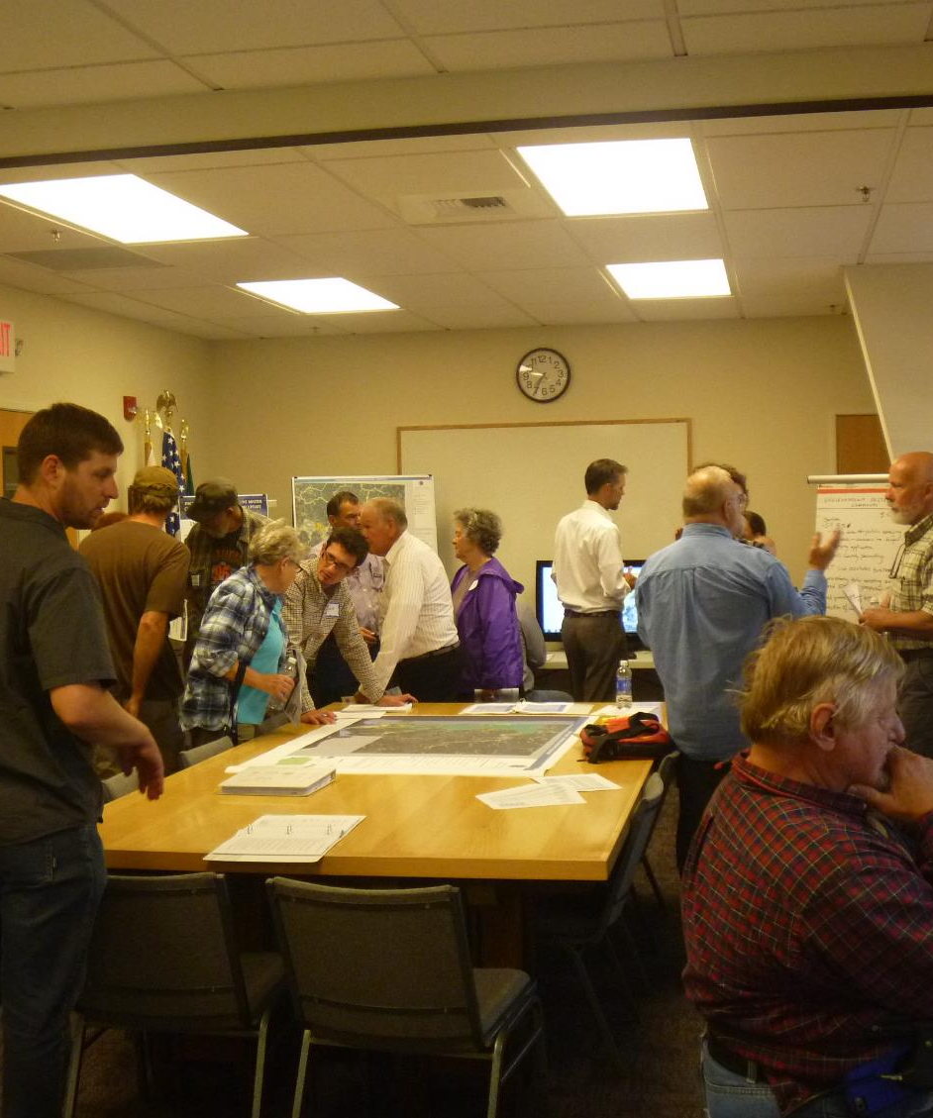
Approach
Mapping Development
Community Engagement
Audit of Existing Development
Regulations and Policies
Vulnerability and Risk Assessment Report

Slide 10
Project Analyses

Slide 11
Map Development Overview
QAPP
Choose Projections
Aggregate Data
Make Maps
Assess Impacts
Develop Models
Notes:
Involves working with staff and partners to select SLR projections based on probabilities and time scales
Critical Infrastructure – first responder facilities, schools, wastewater treatment facilities, roads, wetlands
Work with Blue Coast for wave modeling

Slide 12
Projections – What are they?
How are Sea Level Rise (SLR) & flood levels estimated?
  Probability Confidence
  International predictions based on emissions
  Tide gauge trends – Mean Higher High Water (MHHW) and extreme flood
Relative Sea Level Rise
  Absolute SLR + Land Movement
Confidence Intervals by year

Slide 13
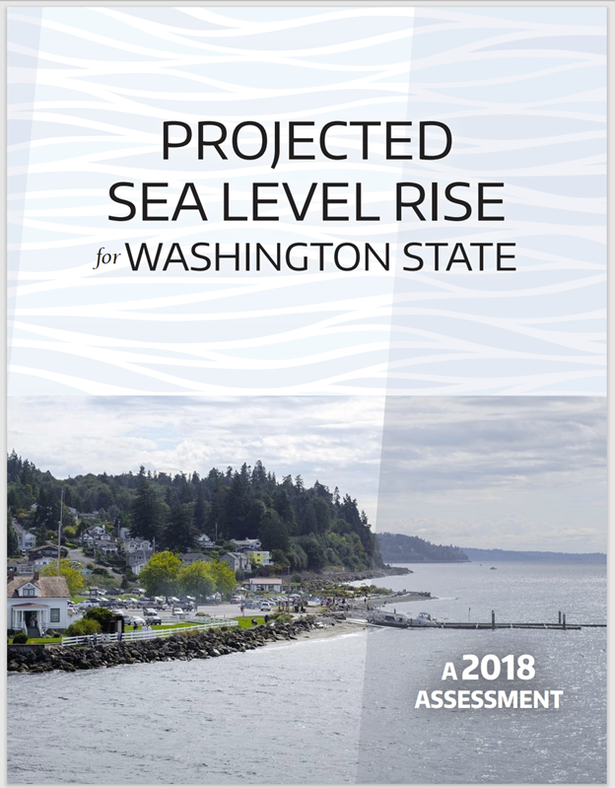
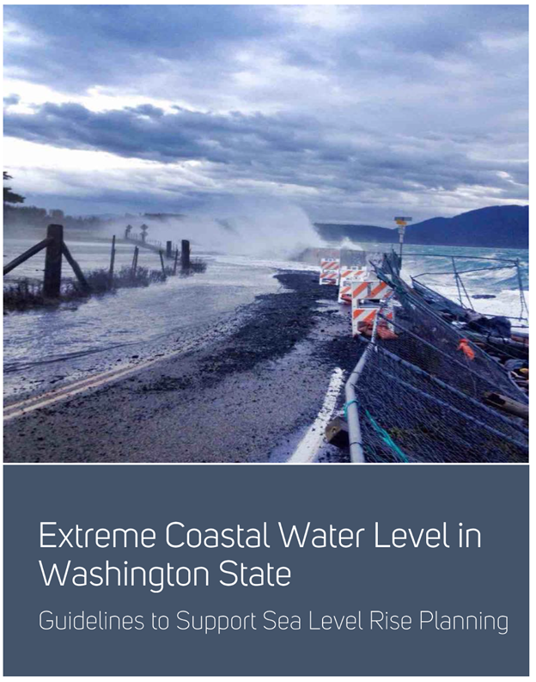
Projections - Where do the levels come from?
2018 Report
  “Stillwater”, no wave run-up
2019 Report
  Extreme water levels seen by tide gauges
Resilience Resource Library | Washington Coastal Hazards Resilience Network (wacoastalnetwork.com)
Washington Sea Grant - YouTube
Notes:
Will stay in touch with Sea Grant and CIG to ensure the most up to date information is being used.

Slide 14
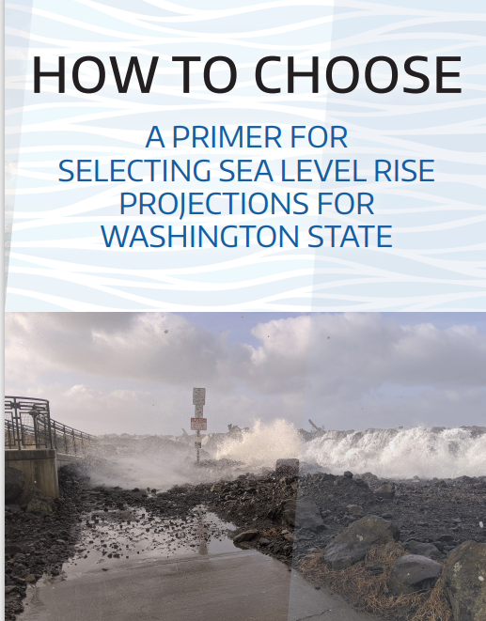
Projections – Selected by Technical Advisory Committee
1. RCP: 4.5 or 8.5
2. Timeframe: 2050? 2060? 2100? 2150*?
3. Certainty/Level of Risk: 1% (less likely),
50%, 90% (very likely)
Notes:
RCP – Representative Concentration Pathways

Slide 15
Next Steps - Modeling
SLR:
Projections displayed over a DEM,
Intersect mapped resources with new tidal surfaces,
Quantify and rank impacts
Wind-Wave:
1-D wind-wave hindcast on shoreline reaches w/ moderate to high wind-wave energy
Estimate wind-wave runup using empirical methods

Slide 16
Assets for Vulnerability Assessment
Roads, Transportation
Hospitals, Police Stations, Fire Depts
Schools, Libraries
Residences
Agricultural, Farmland
On-site septic systems
Electrical Substations
Historic and Cultural Resources
Group A Wells, WWTPs
Beach Access, Parks
Wetlands, Estuaries
Marinas, Bays
Brownfield Sites, Landfills

Slide 17
What this project does not include:
Site-specific or property-level scale analyses
Future bluff erosion rates due to sea level rise
Analysis of tsunami or Cascadia Subduction Zone earthquake risks
Economic analysis of sea level rise impacts
Groundwater modeling or saltwater intrusion studies
Analysis of impacts on riverine systems

Slide 18
Vulnerability and Risk Assessment Report
Summarize the findings from
the mapping exercises
Recommendations for adaptation strategies including near and long- term planning efforts
Identify next steps to address gaps in information

Slide 19
Audit of Existing Development Regulations and Policies
Review applicable regulations and policies including the following:
  Shoreline Master Program (SMP)
  Flood Hazard regulations
  Critical Areas Ordinance (CAO)
  Comprehensive Plan
Summary of recommended
updates to applicable
regulations and policies

Slide 20
Community Engagement

Slide 21
Community Engagement
Community Engagement Plan
Outreach Events
Open House Events
Planning Commission
Board of County Commissioners
Focused Outreach & Coordination
Public Information Meetings
ArcGIS Storymap
Notes:
Assist with Tribal engagement if necessary

Slide 22
Timeline
Project Kick-off | June 2024 | Public Announcement, Website Materials
TAC Meeting #1 | June 2024 | Kick off meeting with TAC, Review project and roles
TAC Meeting #2 | July 2024 | Determine SLR projection to be used in Assessment
Planning Commission / Board of Commissioners Brief | August 2024 | Project Overview and Outreach Approach
Community Advisory Council Briefs | September 2024 | Project Overview
Public Meeting #1 | September 2024 | Project Overview
Public Survey | September 2024 | Public and Agency Surveys on Concerns and Priorities
TAC Meeting #3 | November 2024 | Review of Preliminary Maps
Public Meeting #2 | December 2024 | Review Draft Maps, Survey Results and Preliminary Findings
Draft Documents | January 2024 | Draft Maps Published
TAC Meeting #4 | February 2025 | Review and Discussion of Draft Audit Summary Memorandum and Report
Planning Commission Meeting /Public Meeting #3 | March 2025 | Review and Discussion of Draft Audit Summary Memorandum and Report
Board of Commissioners/Public Meeting #4 | May 2025 | Review and Discussion of Final Documents and draft amendments contained within the Audit Summary Memorandum.
Final Report | June 2025 | Final Documents Published

Slide 23
Role of the Technical Advisory Committee (TAC)
Establish projections &
provide input on mapping priorities
Identifying specific areas of concern and gaps
Informing future code and plan amendments
Consider and utilize feedback obtained from the Public Meetings in developing the priorities, maps, and strategies

Slide 24
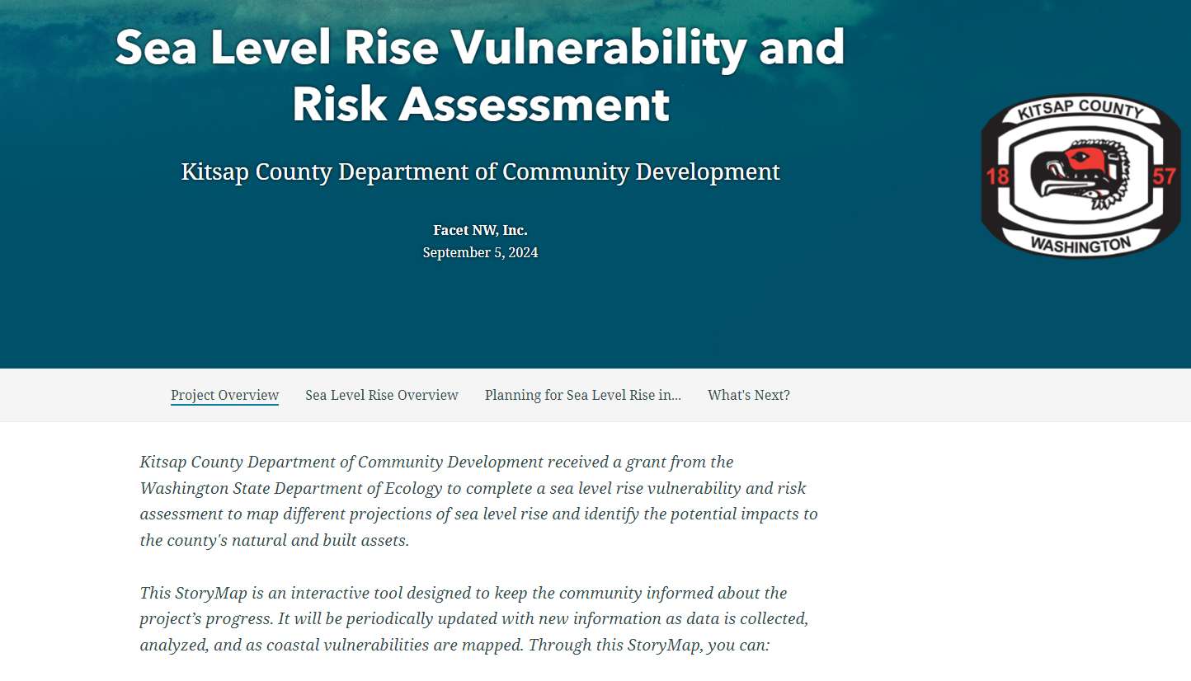
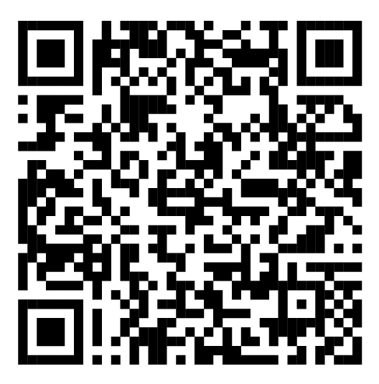
Project StoryMap
Kitsap County Sea Level Rise Vulnerability and Risk Assessment Story Map

Slide 25
Project StoryMap
Sea Level Rise Overview
  Impacts of SLR
  Projections
Decisions made for this assessment
Coming Soon:
  Survey Results
  Assessment maps

Slide 26
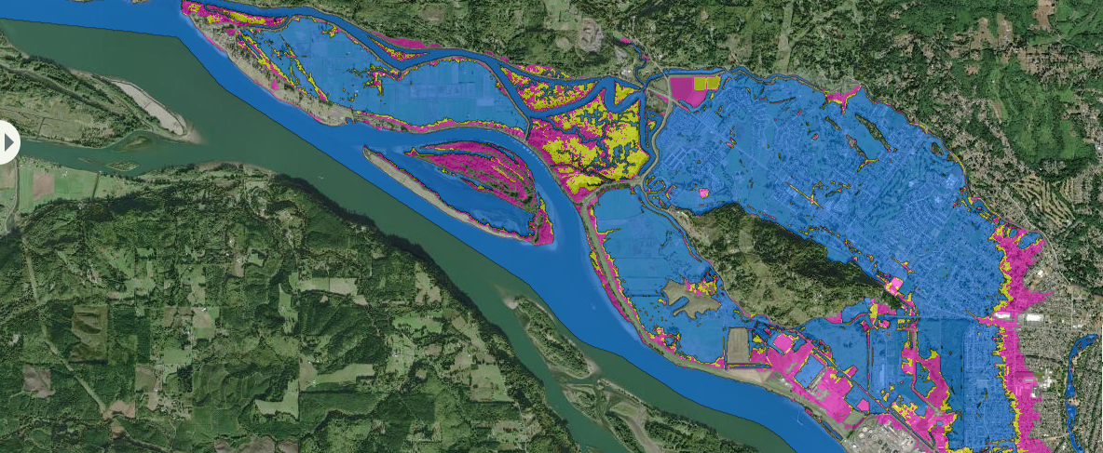
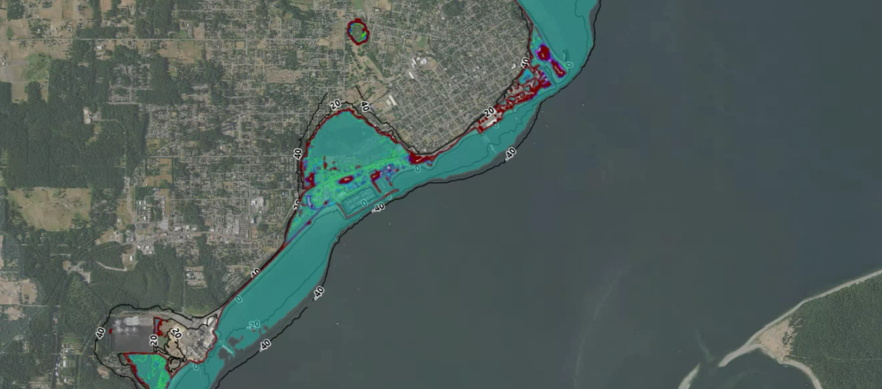
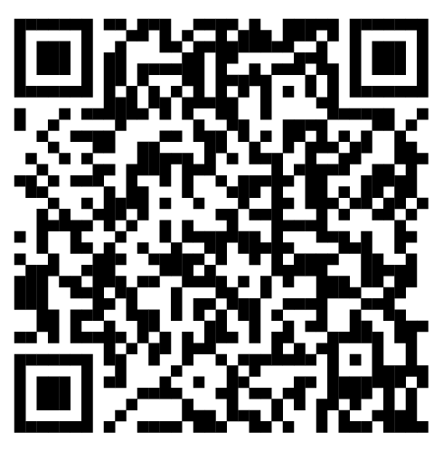
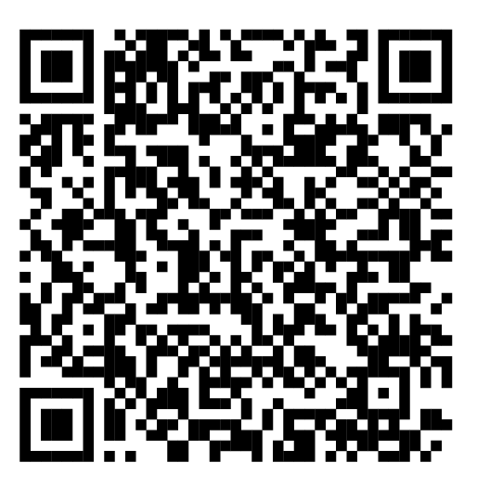
Story Map Examples
Pacific County SLR Story Map
Port of Port Townsend SLR Web Map

Slide 27
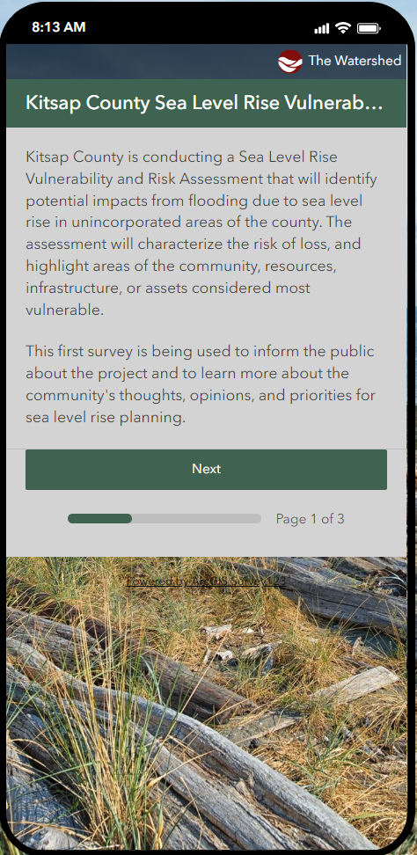
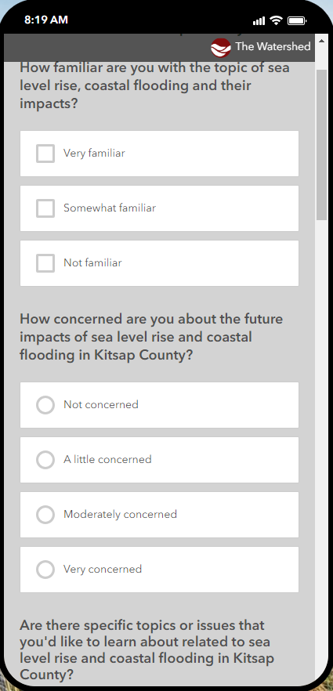
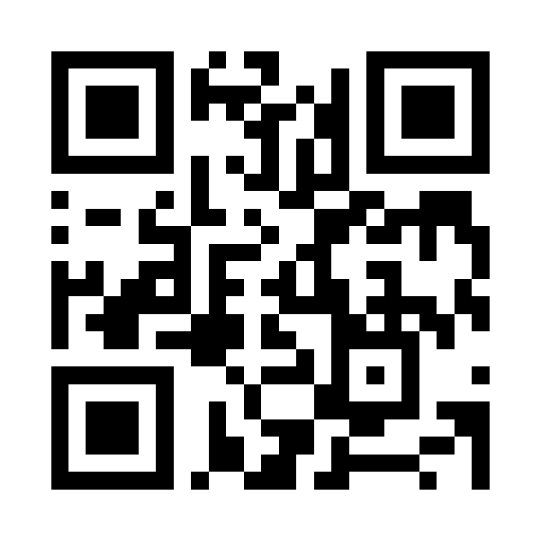
Public Survey #1
Go to the project website to take the online survey!
http://kcowa.us/KitsapSLR
Or scan the QR code below:

Slide 28
Open House Activities
Question and Answer
Prompts and Mapping
Activity #1 – Prompt Response
Are there specific topics that you’d like to learn about related to sea level rise and coastal flooding in Kitsap County?
Activity #2 – Prompt Response & Mapping
Which natural and built assets do you consider most important for this assessment?
Activity #3 – Prompt Response & Mapping
Have you seen or experienced coastal flooding anywhere in Kitsap County?

Slide 29
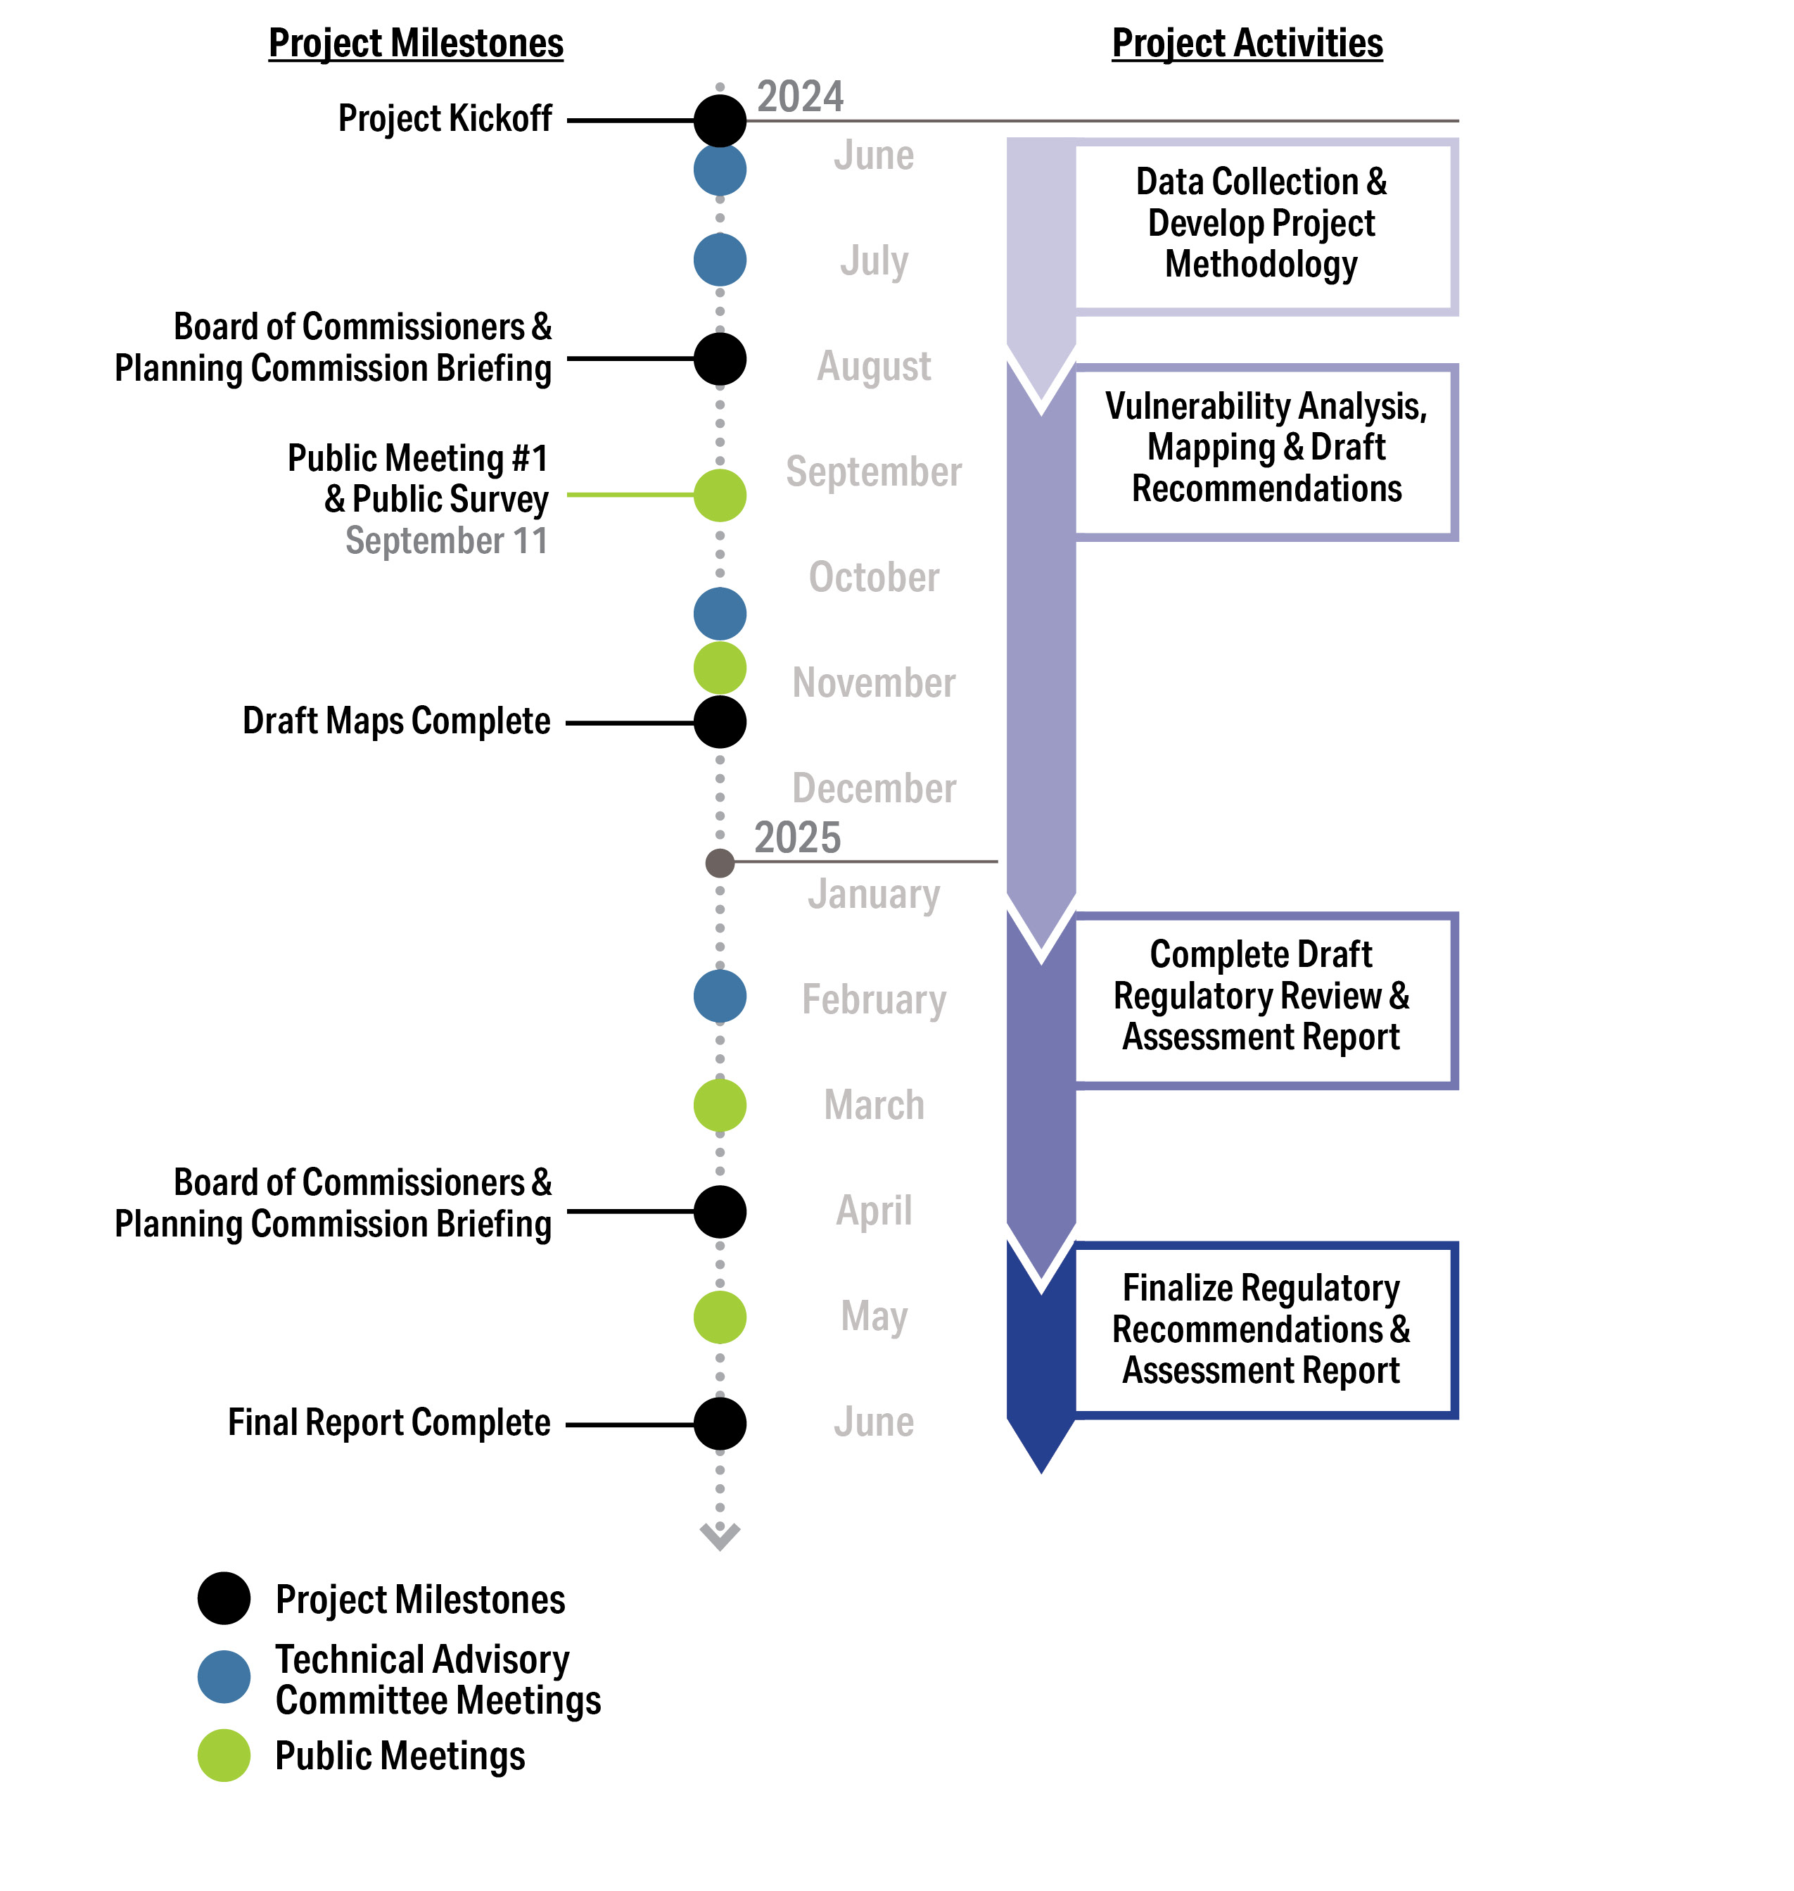
Next Steps

Slide 30
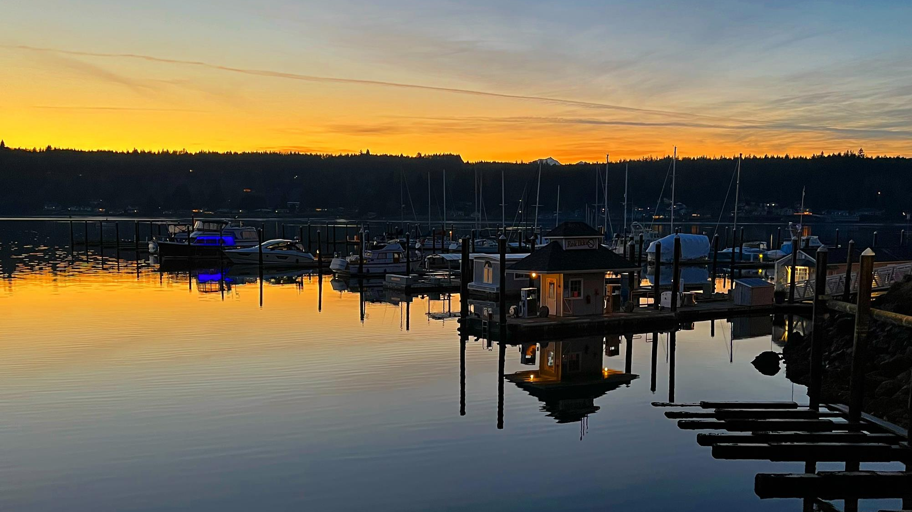
KITSAP COUNTY
Sea Level Rise Vulnerability
and Risk Assessment
Public Open House
September 11, 2024

