Slide 1
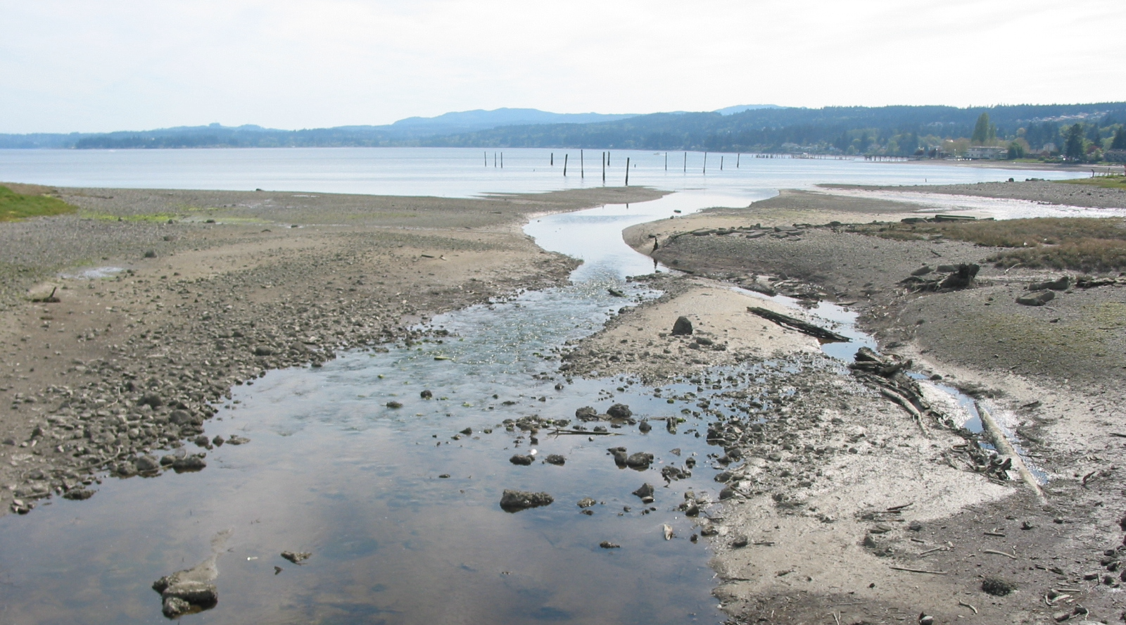

Department of Community Development
Year of the Rural – Project Presentation and Open House
Heather Cleveland, Long Range Planner
September 11, 2025

Slide 2
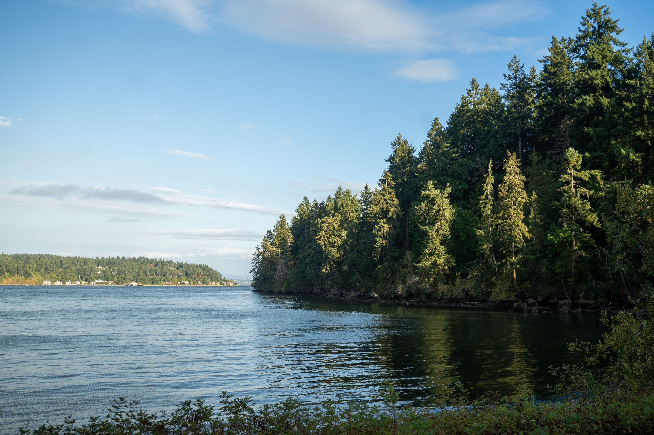
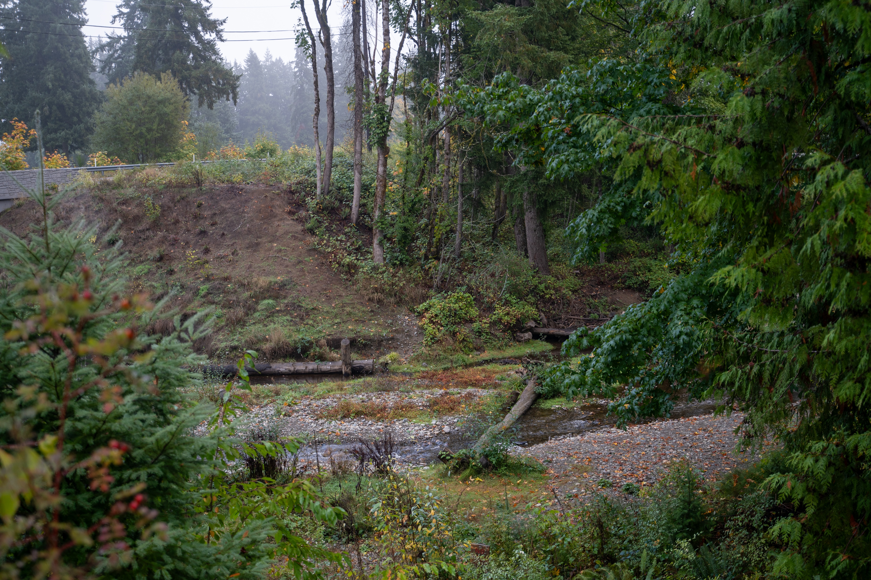

Agenda
Project Overview
Growth Management Act (GMA)
2024 Kitsap County Comprehensive Plan
Outreach Overview
Rural and Resource Lands Chapter
Proposed Code Updates
Reclassification Requests
What’s next?
Project Webpage
Notes:
Top Photo: Manchester State Park
Bottom Photo: Chico Creek

Slide 3


Project Overview
Charter & Community Engagement Plan
Deliverables: Rural and Resource Lands Chapter Update, Potential Code Updates, Reclassification Request Recommendations
Outreach & Engagement
Research and Gap Analysis
Data Analysis and Mapping
Notes:
Photo: Whispering Firs Stormwater Park

Slide 4
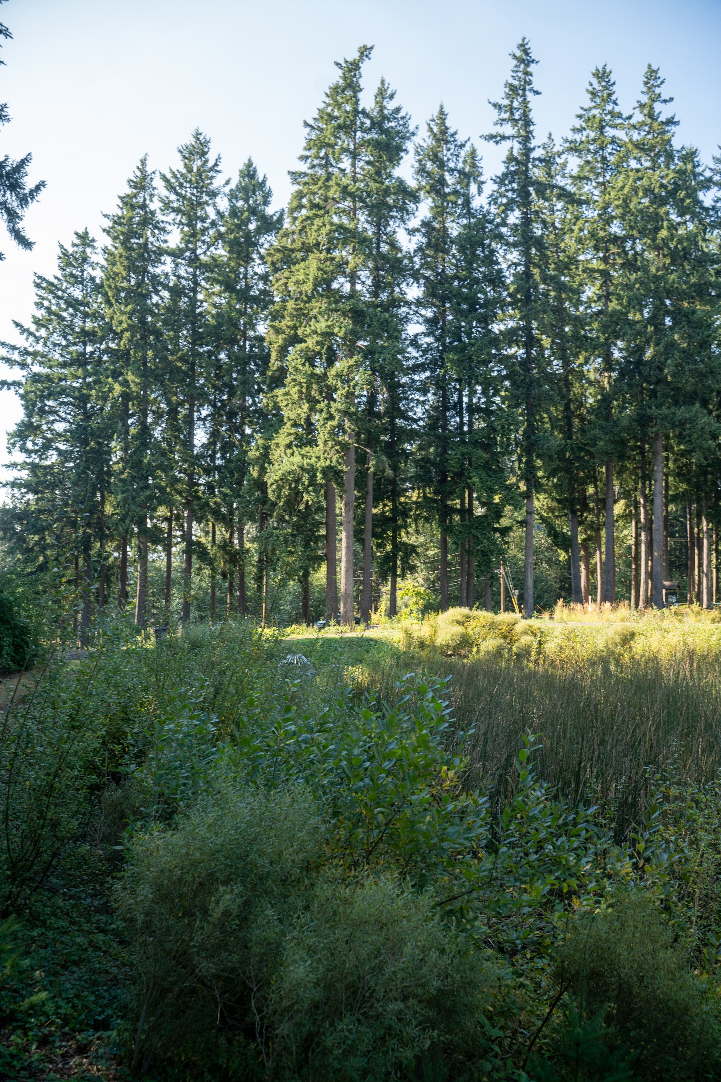
Growth Management Act (GMA)
Planning Goals
Mandatory Elements – Rural Element
Three Main Types of Lands
Tiered Planning
Vision 2050 & Multi County Planning Policies
Countywide Planning Policies
Local Comprehensive Plans
Kitsap County’s History
Today in Kitsap County
Is there a fourth type of land?
Notes:
Photo: Whispering Firs Stormwater Park
Chapter 36.70A RCW: GROWTH MANAGEMENT—PLANNING BY SELECTED COUNTIES AND CITIES

Slide 5

2024 Kitsap County Comprehensive Plan
Introduction
Chapter 1 Land Use
New! Rural and Resource Lands
Chapter 2 Economic Development
Chapter 3 Environment
Chapter 4 Housing
Chapter 5 Transportation
Chapter 6 Parks, Recreation, and Open Space
Chapter 7 Capital Facilities and Utilities
Chapter 8 Climate Change
Subarea and Neighborhood Plans
Notes:
2024 Comprehensive Plan

Slide 6
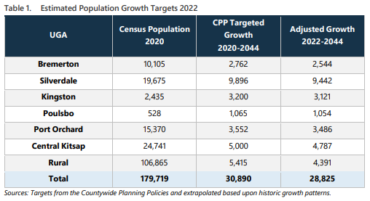
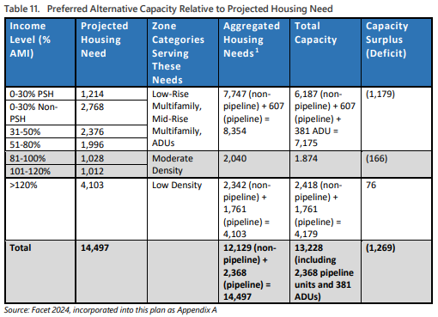
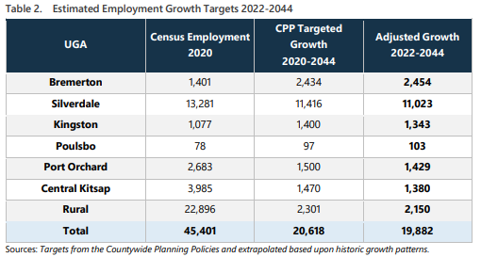
2024 Kitsap County Comprehensive Plan
Notes:
2024 Comprehensive Plan
Land Use Chapter – Table 1 and Table 2
Housing Chapter – Table 11

Slide 7
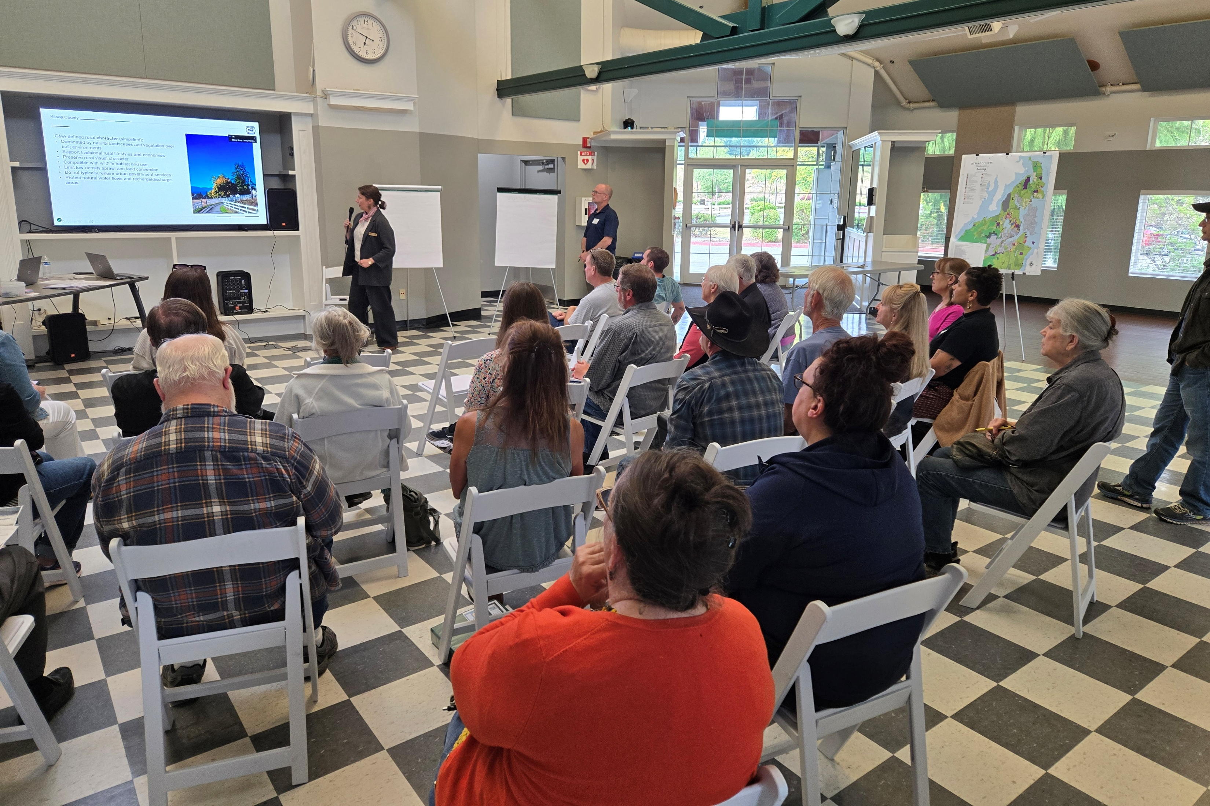
Outreach Overview
Review and Summarize Rural Comp Plan Public Comments
Surveys
Presentations, Interviews, Meetings
Agriculture Working Group
Kitsap County Child Care Task Force
Kingston Rotary
Tribal Coordination Meeting(s)
Kitsap Rural Business Coalition
Kitsap County – Parks Forester and Emergency Management
Survey 1.0 – Feb/March
Survey 2.0 – June/July
DCD: Current Planning, Building & Fire Safety, Environmental Programs
Great Peninsula Conservancy
Gravel Pit Owner; Washington Department of Natural Resources
Workshops
Open House
Public Comment
Public Testimony
Community Advisory Council Presentations
Kitsap Environmental Coalition
Workshop Comment: “Forestry requires access to mills or onsite milling. What provisions are adding small scale industrial zoning to Rural Wooded?
Notes:
Photo: Central Kitsap Workshop

Slide 8
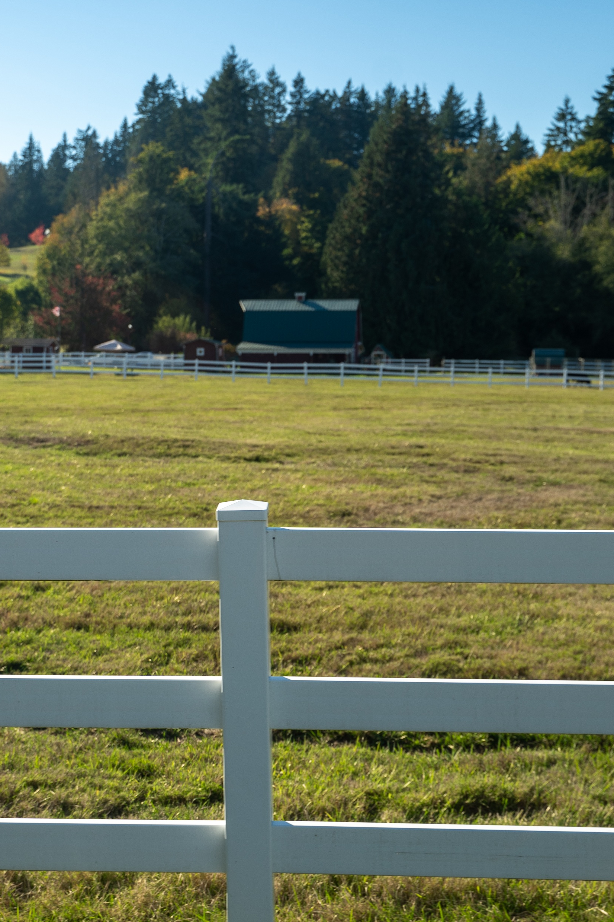
Rural and Resource Lands Chapter
Vision
Rural Character
Intent
GMA and Regional Coordination
Other Applicable State Laws
Relationships to Other Elements
Background of Chapter
Key Terms
Rural Land Use Zoning Designations
Limited Areas of More Intensive Rural Development (LAMIRDs)
Resource Lands and Working Lands
Goals, Policies, and Strategies
Notes:
Photo: Scadia Rural

Slide 9
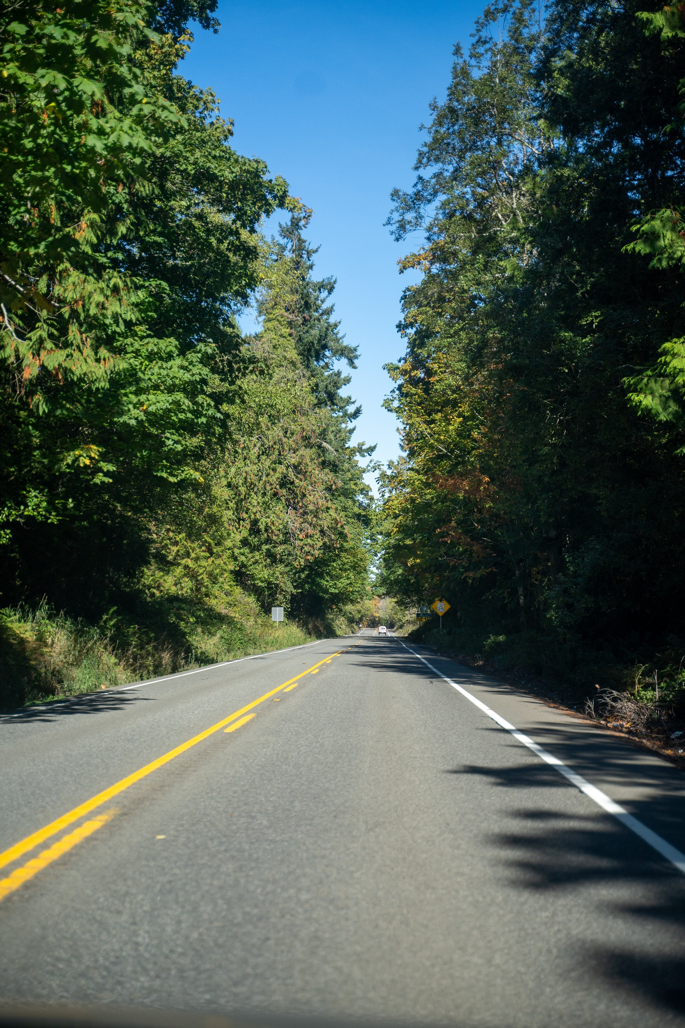
Goals, Policies, and Strategies
Rural Development
Resource Lands and Working Lands
Rural Business
Rural Services and Infrastructure
Rural Environment
Notes:
Photo: Port Gamble

Slide 10
Rural Development
Evaluate tools such as purchase of development rights (PDR), transfer of development rights (TDR) and performance-base development (PBD) for rural areas.
Goal: Retain the rural character of the County outside of designated UGAs.
Limit development in the rural area to appropriate rural uses that do not need urban-level services and facilities.
Develop and adopt design and development standards for rural areas outside of LAMIRDs and rural villages.
Limit the rural area to low residential densities.
Allow rural clustering where appropriate.
Prepare a Rural Lands Analysis to evaluate the current status and future development projects for the rural area.
Evaluate legacy (pre-GMA) lots to identify opportunities for aggregation or other mechanisms to resolve their challenges and constraints.

Slide 11
Resource Lands and Working Lands
Goal: Protect and conserve designated resource lands and working lands.
Allow industrial uses associated with forestry activities in the forest resource land zone.
Reduce loss of agriculture, forestland and timber production through incentives and other mechanisms.
Form a Forestry Advisory Council for long-term planning and outreach.
Goal: Conserve and manage mineral resource lands for long-term supply and land use compatibility.
Review and revise Mineral Resource designations using updated data.
Ensure that future reclamation plans are consistent with the comp plan and surrounding land uses.
Goal: Conserve and enhance agricultural lands.
Encourage preservation of historic farms.
Form an Agriculture Advisory Council for long-term planning and outreach.
Adopt policies to promote greater accessibility to water rights for agricultural usage.

Slide 12
Rural Business
Goal: Foster rural businesses on rural commercial and industrial lands while protecting rural character.
Update the zoning code to allow home-based cottage-type businesses and industries that do not negatively impact rural character.
Allow family day care providers in all zones that allow residential or commercial use.
Goal: Enable social gatherings and related business opportunities while ensuring that scale and activities are compatible with rural character and neighboring properties.
Establish and conduct outreach on standards for events to minimize impacts.
Allow flexibility for temporary or seasonal events while ensuring they do not cause long-term land use conflicts.
Goal: Increase the availability of child care to rural residents.

Slide 13
Rural Services & Infrastructure
Goal: Maintain appropriate rural levels of service for public services and facilities.
Prioritize maintenance of existing facilities and services without creating capacity for urban-level growth.
Evaluate potential options for improvements to public transit in the rural area.
Update the comp plan to address development of battery energy storage systems (BESS) and large-scale data centers in rural areas.
Goal: Sustain the character of Type I LAMIRDSs through appropriate infill and development.
Allow creation and expansion of essential rural retail services in Type I LAMIRDs.
Update development regulations for Type I LAMIRDS to allow appropriate infill.
Consider allowing "middle housing" in Type I LAMIRDS where appropriate.
Goal: Enhance rural walkability and bikeability.
Encourage rural development patterns that provide safe, accessible pedestrian and bicycle connections.

Slide 14
Rural Environment
Goal: Protect natural ecosystems and resources in the rural area.
Coordinate with KNRAMP to develop watershed plans.
Improve understanding of the management, capacity and compliance of rural Group B water systems.
Goal: Prevent and control noxious weeds.
Promote community awareness and education on noxious weed identification, prevention, and management.
Goal: Support coexistence with beavers while managing and mitigating negative impacts on property and infrastructure.
Develop strategies to address and mitigate conflicts caused by beaver activity.
Encourage preservation of areas with high potential for natural beaver recolonization.
Goal: Reduce stormwater impacts on salmon and streams.
Preserve and restore stream buffers and natural drainage corridors.
Encourage use of rain gardens, permeable surfaces, and other low-impact stormwater techniques.

Slide 15
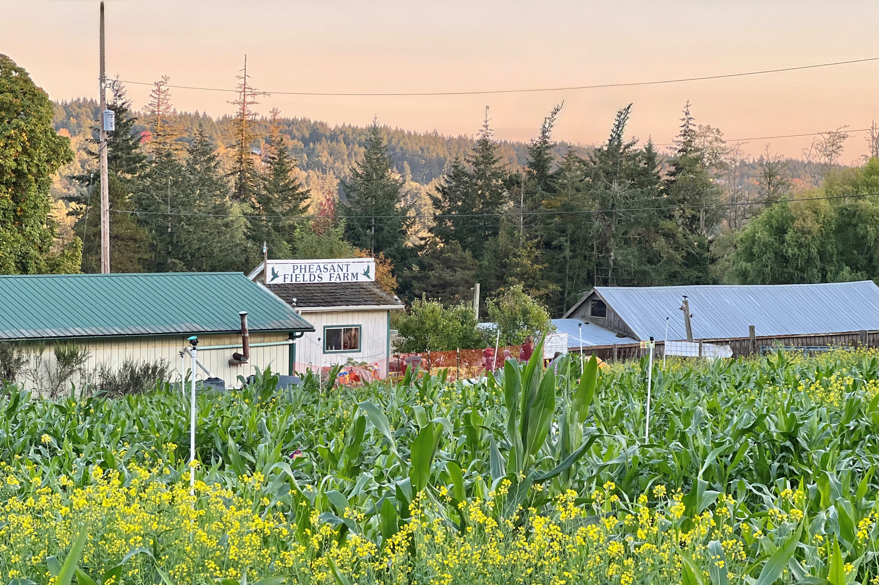
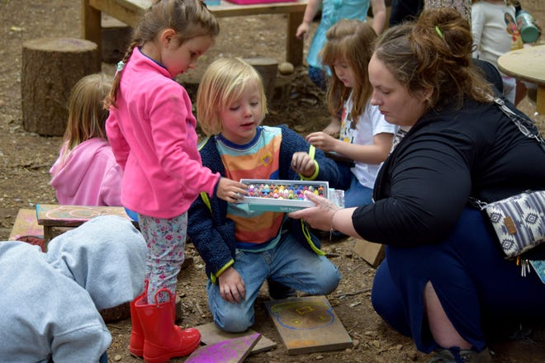
Proposed Code Updates
Actively Evaluating
  Childcare
  Horse Boarding
  Agriculture
Future
  Boundary Line Adjustments
  Battery Energy Storage Systems – Moratorium
  Reclassification Request Process
  Events
  Rural Lands Analysis
  In-Home Business
  Mobile Home Park Preservation
Notes:
Top Photo: Manchester State Park
Bottom Photo: Kitsap Sun – “Samantha Henderson, a teacher at Key Peninsula Forest Friends and Nature School, hand chalk to a student on June 4. Changes to WA laws hoped to spur increase in childcare options

Slide 16
Child Care Code
Allow family day care and child care centers in most zones without a conditional use permit.
Provide reasonable approval and operating standards to ensure compatibility with surrounding neighborhoods.
Simplify the permit review process to encourage establishment of child care and family day care services.

Slide 17
Equestrian Facilities Code
Equestrian facilities are commercial facilities for equine boarding, breeding, riding lessons, training, and events.
Stabling, riding and pasture for use solely by a property owner's own horses is not an equestrian facility.
The equestrian facilities code is not retroactive for existing facilities, unless otherwise determined by the County Commissioners to protect public health and safety.
Administrative CUP for boarding-only facilities; CUP for facilities providing additional services.
Standards for site design and operation to limit impacts to neighboring properties and protect public health, safety and welfare.
Any other commercial uses on the property require separate review and permitting.

Slide 18
Equestrian Facility Code Q&A
Problem
Outreach
Economic Impact
Code Origin
Consult
Grandfathered/Retroactive
Add paddock or upgrade existing facility
Unintentionally force out

Slide 19
Agriculture Code
Equestrian facilities are commercial facilities for equine boarding, breeding, riding lessons, training, and events.
Stabling, riding and pasture for use solely by a property owner's own horses is not an equestrian facility.
The equestrian facilities code is not retroactive for existing facilities, unless otherwise determined by the County Commissioners to protect public health and safety.
Administrative CUP for boarding-only facilities; CUP for facilities providing additional services.
Standards for site design and operation to limit impacts to neighboring properties and protect public health, safety and welfare.
Any other commercial uses on the property require separate review and permitting.

Slide 20
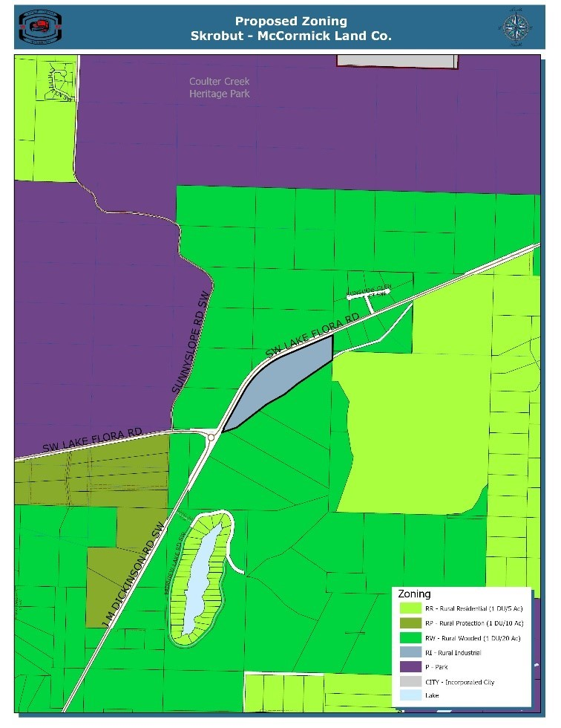
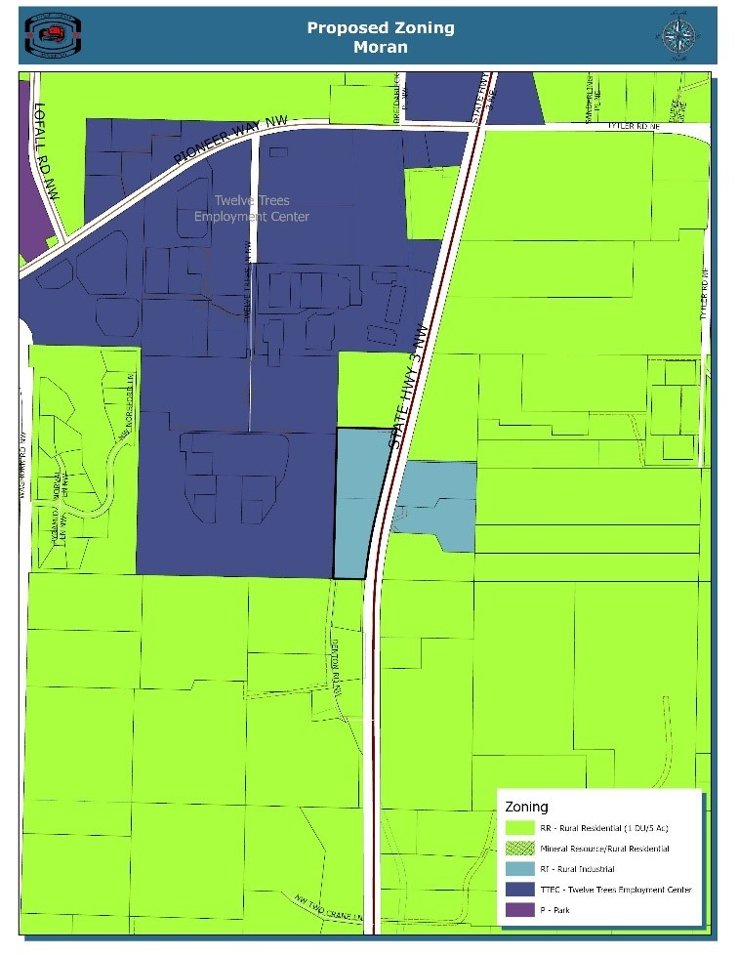
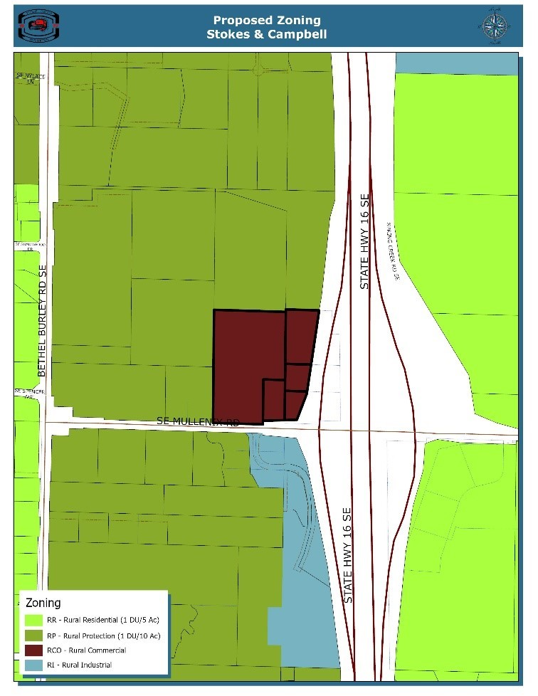
Reclassification Requests
Rural Commercial and Rural Industrial
App ID #07: RW to RI or RCO
Skrobut-McCormick
App ID #58: RR to RI
Moran
App ID #66: RP to RCO
Stokes & Cambell
Notes:
Chapter 21.08 LEGISLATIVE ACTION PROCEDURES: 21.080.070 Criteria for recommendation or decision – General.
Year of the Rural – See the “Rural Land Use Reclassification” dropdown.

Slide 21
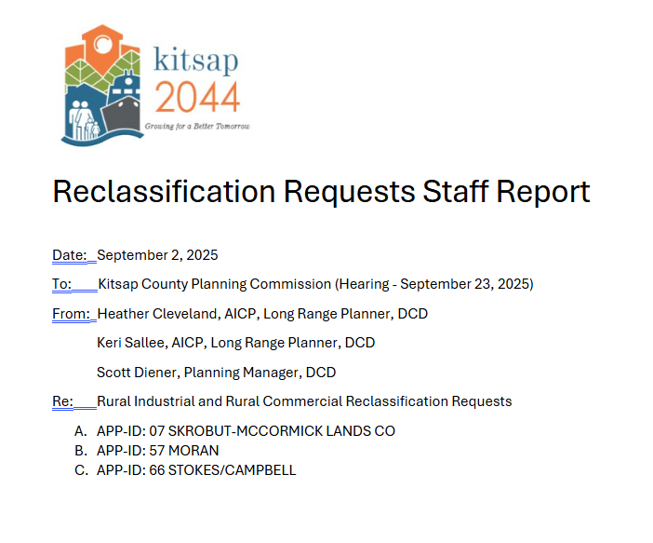
Reclassification Requests
Rural Commercial and Rural Industrial
Notes:
Chapter 21.08 LEGISLATIVE ACTION PROCEDURES: 21.080.070 Criteria for recommendation or decision – General.
Year of the Rural – See the “Rural Land Use Reclassification” dropdown.

Slide 22
Reclassification Requests
App ID #07: Skrobut-McCormick
Findings of Fact
Application. The applicant, Doug Skrobut, President of McCormick Land Company and owner of the subject property, submitted the application to Kitsap County on June 15, 2022.
Request. The applicant seeks a Comprehensive Plan Amendment to change the current zoning of one parcel from Rural Wooded (RW) to Rural Industrial (RI) or Rural Commercial (RCO).
Location. The parcel is located along SW Lake Flora Rd.
Surroundings use. The parcel is surrounded by parcels in current timber production, several parcels with housing, Coulter Creek Heritage Park, and the Trophy Lake Golf Course.
Current use. The subject property has pre-GMA industrial/commercial development.
Adjacent zoning. Adjacent properties are zoned Rural Wooded, Rural Residential, and Park.
Road type. The property is located on SW Lake Flora Rd – a minor arterial and County Road between two major arterials, SR-16 and SR-3.
Critical areas. The Building Limitations - Critical Areas Maps show a Type N stream to the south that may have buffers on the subject property or extend into the property.
Rural services. Proposed development would be required to be consistent with rural levels of service.
Proposal specific issues. The applicant is open to either RI or RCO redesignation and acknowledged that RCO may be a better fit.
Tentative Recommendation
Approval
App ID #07: RW to RI or RCO
Skrobut-McCormick
Notes:
Chapter 21.08 LEGISLATIVE ACTION PROCEDURES: 21.080.070 Criteria for recommendation or decision – General.
Year of the Rural – See the “Rural Land Use Reclassification” dropdown.

Slide 23
Reclassification Requests
App ID #58: Moran
Findings of Fact
Application. The applicant, Humberto Moran, owner of the subject property, and representative, Kathy Cloninger, submitted the application to Kitsap County on June 15, 2022.
Request. The applicant seeks a Comprehensive Plan Amendment to change the current zoning of one parcel from RR to RI.
Location. The parcel is located along SR-3.
Surroundings use. The parcel surrounded by parcels in Twelve Trees Employment Center, single family and mobile homes, light industrial/commercial warehouse building and outbuildings, and undeveloped land.
Current use The subject property has a shed/garage constructed in 1994.
Adjacent zoning. Adjacent properties are zoned Twelve Trees Employment Center, Rural Residential, and Rural Industrial.
Road type. The property is located on SR-3, a state highway.
Critical areas. A wetland delineation report provided by the applicant indicates that a Category III wetland is on the west side of the property. The Building Limitations – Critical Areas Map shows a linear area of high erosion hazard extends through the middle of the property.
Rural services. Proposed development would be required to be consistent with rural levels of service.
Proposal specific issues.
The applicant also owns the property to the north with an open code violation compliance case, and no permits for development were issued on the subject parcel.
If the current application is approved, the property to the north would become a RR zone island.
Tentative Recommendation
No recommendation
App ID #58: RR to RI
Moran
Notes:
Chapter 21.08 LEGISLATIVE ACTION PROCEDURES: 21.080.070 Criteria for recommendation or decision – General.
Year of the Rural – See the “Rural Land Use Reclassification” dropdown.

Slide 24
Reclassification Requests
App ID #66: Stokes & Campbell
Findings of Fact
Application. The applicants, Jeff Stokes and Craig Cambell, owners of the subject properties, and representative, William Palmer, submitted the application to Kitsap County on June 15, 2022.
Tentative Recommendation
Conditional approval
Request. The applicant seeks a Comprehensive Plan Amendment to change the current zoning of five parcels from RP to RCO.
Location. The parcels are located along SE Mullenix Rd.
Surroundings use. The parcels are surrounded by SR-16, gas station and convenience store, park and ride lot, and single-family residences.
Current Use. The subject properties currently have a single-family residence and a mobile home on separate parcels, and the remaining is forested.
Adjacent zoning. Adjacent properties are zoned Rural Protected, Rural Industrial, and Rural Residential.
Road Type. The property is located on SE Mullinix Road, a county road, and adjunct to SR-16, a state highway.
Critical Areas. The Building Limitations – Critical Areas Map shows the southeast and large northeast parcel are heavily encumbered by critical areas. Burley Creek, a Type F Streams runs through these properties within a mapped wetland corridor. Areas of seismic and geologic hazards are on three of the five properties.
Rural Services. Proposed development would be required to be consistent with rural levels of service.
App ID #66: RP to RCO
Stokes & Campbell
Notes:
Chapter 21.08 LEGISLATIVE ACTION PROCEDURES: 21.080.070 Criteria for recommendation or decision – General.
Year of the Rural – See the “Rural Land Use Reclassification” dropdown.

Slide 25
What’s Next?
September 2 – Publish Draft Deliverables; Public Comment Period Opens
September 2 – Manchester CAC Presentation
September 3 – Central Kitsap CAC Presentation
September 10 – Kingston CAC Presentation
September 11 – Year of the Rural Public Presentation (Hybrid) and Open House at Kitsap County Administration Building
September 23 – Planning Commission Hearing – Opportunity for Public Testimony
October 7 – Planning Commission Deliberations
October 21 – Planning Commission Findings of Fact and Recommendations
November 10 – Board of County Commissioners Hearing – Opportunity for Public Testimony; Public Comment Period Closes
November TBD – Board of County Commissioners Deliberations
December 8 – Board of County Commissioners – Potential Adoption

Slide 26
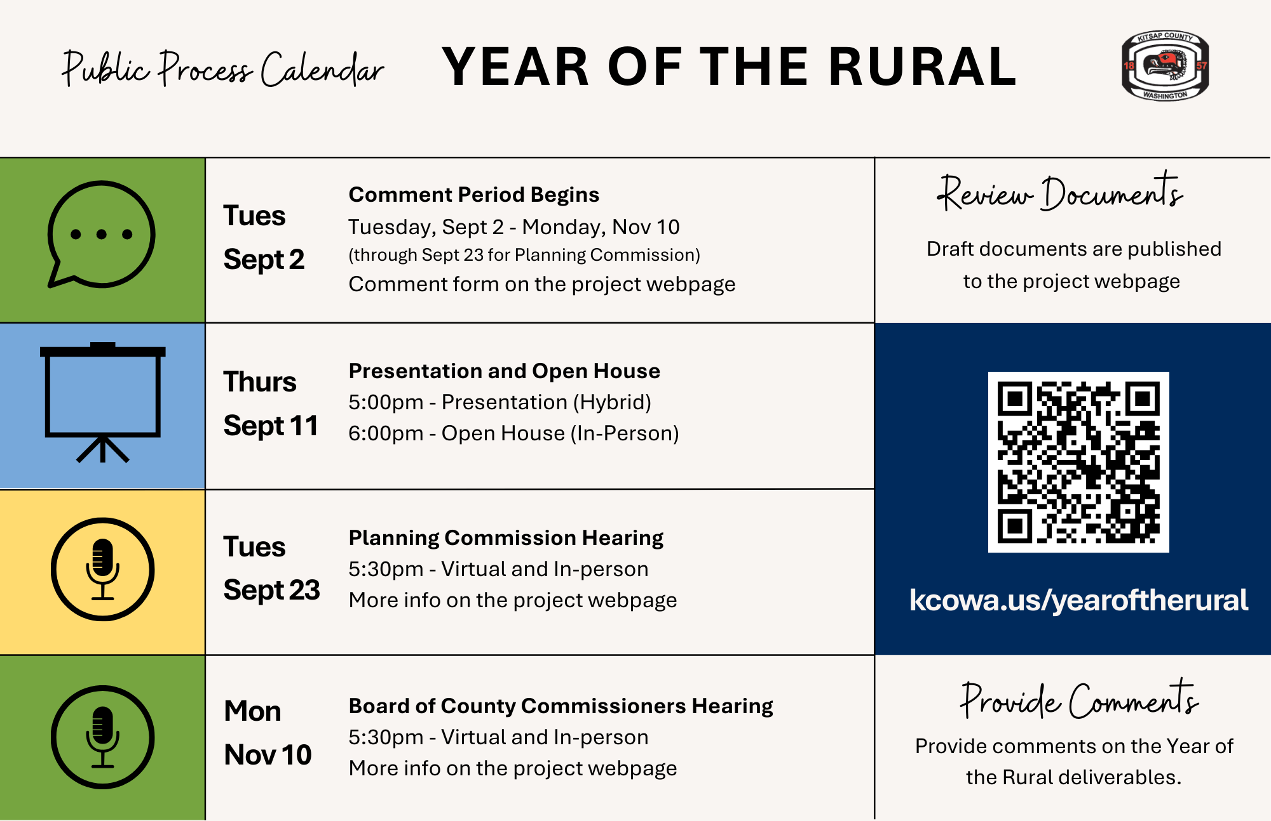

Slide 27
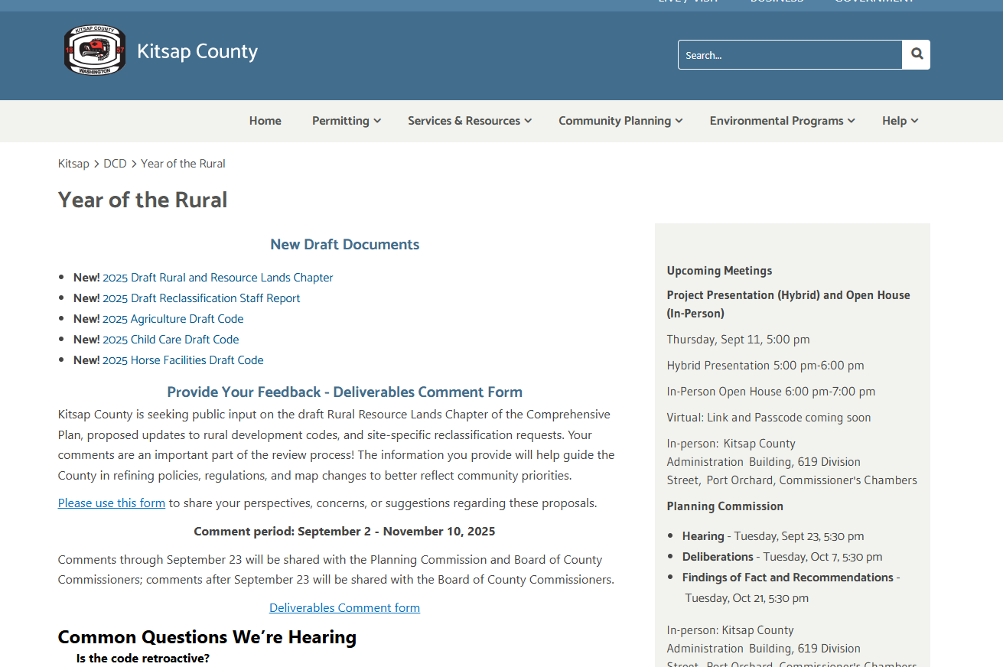

Slide 28
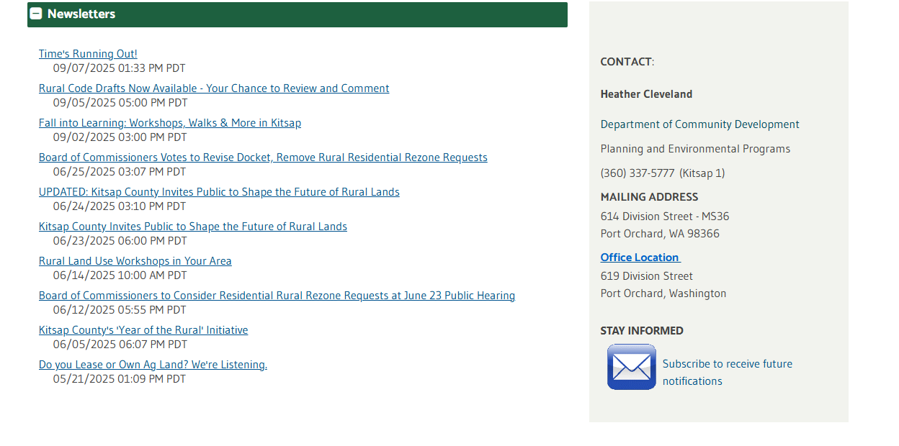

Slide 29
Thank you!
Heather Cleveland
Long Ranger Planner
Email: hcleveland@kitsap.gov

